Slide 1

Service Management Automation (SMA) Suite Technical Presentation Training, Level 320 Module 2 – Technical Customer Facing Presentation
Carol Hibbard
You can:
Download the presentation.
Download PowerPoint slides & speaker notes.
October 2018
Notes:
[STANDARD SLIDE: L300 (animated)]
You can change out the photo with any image from Getty Images in DropBox.
If the main title is shorter, you can make the font larger.
You may have to move the title text around depending on the photo. Make sure the text is readable against the background photo.
You can change the background color for the rectangle in the bottom-right corner to look better against the background. Choose a Micro Focus color at 25% transparency.
=========================
Note to Narrator or Reader: [PRESS] indicates press the Page Down key to show the animation
=========================
Hello and Welcome to the [COURSE_NAME] Technical Overview Training, Level 300.
In this course you’ll gain a high-level understanding of the essentials of [PRODUCT_NAME].
[PRESS] If you want to download this presentation and save it on your own system, click the Tools & Help icon in the bottom-right corner of your Brainshark window and select Download.
Or, if you want to access the PPT slides and speaker notes for future reference, go to the Attachments tab in Brainshark and click to download the presentation.

Slide 2
Service Management Automation X The machine learning based Service Desk delivered on-premise or cloud
April 2018

Slide 3




Before you begin
Key notes on how to use this presentation
This presentation is designed to be presented in a non-linear fashion. All slides are NOT intended to be used in a single presentation, rather to generate discussion and create an on the fly discussion with customers. Below are the different icons that are used to navigate the presentation.
Master home page, contains all key value statements
Description slides – includes definition, use cases and key functions
Technology slides – describes technology behind the different capabilities
Screenshot slides – includes pictures of the system with callouts on features
Video links – links to videos demoing features (video files must be in the same folder)
Return – navigates back to key value statement capability page
Navigate forward or backward on slides that have multiple technology or screenshot slides

Slide 4
Service Management Automation
Innovative architecture, built for agility and scale
Feature Overview
Smart self-service with social collaboration
Modern user experience for enterprise applications
Codeless configuration and easy updates
ITOM platform with deployment choice
Additional Information
Mobile
Chatbots
Smart Email
Portal
Service Experience
ITIL® Processes
Asset Management
Apps and APIs
API
Automation & Orchestration
Machine Learning & Analytics
Configuration Management
Discovery
Container Deployment Foundation
Physical
Virtual
Cloud
Container
Notes:
[NOTE: Some of the capabilities described here are only available with SMAX. See slides 17 and 18 for details]
As discussed before, today’s IT service desks are complex and costly: slow responses, frustrated users who bypass the service desk, manual processes, high maintenance effort and no choice of deployment. How can Service Management Automation help with this situation?
SMA is the first application suite for IT Service Management and IT Asset Management built on machine learning and analytics, integrated with CMDB and Discovery. It can be deployed anywhere (private or public cloud) due to its container based platform. Its scalable multi-tenant architecture with deployment either on premise or cloud makes it easy to install, configure, and run.
Service desk built upon analytics and machine learning provides capabilities like Smart Ticket, which uses an Optical Character Recognition (OCR) and machine learning system to automatically accept and route service requests. Virtual agents provide automated assistance with integrated live-chat or email to enhance continuous customer support. Hot Topic Analytics uses advanced search and analytics capabilities to enable you to view and analyze patterns in incidents, requests, and other records and to create knowledge articles or problem records based on those patterns. Change Analytics feature offers insights based on the available data, and suggestions for improvements in change management. Collaboration via ChatOps allows to share knowledge across teams for fast issue resolution.
Service portal including mobile support Social collaboration features including ability to vote, "ask a friend," or survey to help end-users source answers from the community and enhance end-user autonomy. On-the-fly translation provides end users with access to portal content and service desk updates in their preferred language: Native mobile applications on Android and iOS complement the web service portal with a streamlined, native interface that focuses on key tasks that need to be managed on the go.
Modern user experience for automated enterprise applications SMA includes a comprehensive set of ITIL aligned Service Management applications including Service Request Management, Incident Management, Problem Management, Change Management, Release Management, Service Level Management and Configuration Management. Additionally, it provides applications in the areas of IT Asset Management and Project and Portfolio application, operational project management, human resource workflow, application and service portfolio management, financial tracking, ideation and proposal management.
Codeless configuration radically simplifies the task of creating, configuring and maintaining IT process workflows, enabling fast ITIL process maturity adoption. It enables the management of applications including defining and editing a application's fields, forms, business rules, processes and notifications, as well as importing data and defining custom actions for the application. Seamless updates give customers almost instant access to new features and capabilities.
Deployment choice Container based architecture allows SMA to be deployed on bare metal, virtual machines, or on Amazon Web Services, including availability through the AWS Marketplace. It allows auto scaling at both the node level and pod level, supports deployment of multiple tenants per installation that can be used for development, test, or production environments. Multiple tenant deployments can be used by service providers to host environments for multiple customers within a single installation. The multi-tenant console and grid allow leveraged agents to view and edit records from multiple customers’ SMA tenants in a single user interface.
Let us now see some examples how these capabilities and features look like in the product.

Slide 5
Smart self-service with social collaboration
Capability | Description & Use Case | Technology | Screenshot | Video
Smart Ticket
Smart Email
Smart Search
End User & Agent Chat
Hot Topic Analytics
Change Analytics
Fast CI Detection
Service Portal & Catalog
Native Mobile App
Collaboration (ChatOps)
Surveys
IT News
Public/Social Requests

Slide 6
Description: Smart Ticket
Faster & more accurate automated ticket entry
Image based ticketing – just attach a picture
Takes self-service ticketing to the next level of simplification
Saves the end user time, effort and guess work
Better call routing
Quicker resolution time
Use Cases
End user logs smart ticket from service portal
Service agent reviews and updates ticket
Notes:
Smart Ticket
The Smart Ticket capability enables users to submit self-service support requests in a very simple way.
With HPE Service Manager Smart Analytics in place, there is no need for the user to fill in any fields when submitting a ticket. All the user needs to do is to take a screenshot of the error message, attach it to the ticket, and click the “submit” button. The Optical Character Recognition (OCR) feature of Smart Analytics takes the text from the image and adds it into the Description of the interaction. This is known as the “unstructured data”.
Smart Ticket then takes that unstructured data and proposes the ticket classification based upon its learning of past interactions, setting the Category, Subcategory, Area and Affected Service.
Another option for the user is to just type in a couple of text lines to describe the error in natural language. All of the ticket details are completed automatically in the backend.
A superior user experience, better call routing, quicker resolution time
Automated ticketing for a superior End User experience:
Image based ticketing – just attach a picture
Takes self-service ticketing to the next level of simplification
Saves the end user time, effort and guess work
Faster and more accurate categorization, more accurate ticket routing.
IT Agent is more efficient as classification of interaction is proposed based off Smart Analytics learning from past tickets and therefore more accurate.
Via Web Client, an IT Agent can submit a Smart Ticket by just typing a Description, clicking Smart Classification and then Continue.

Slide 7
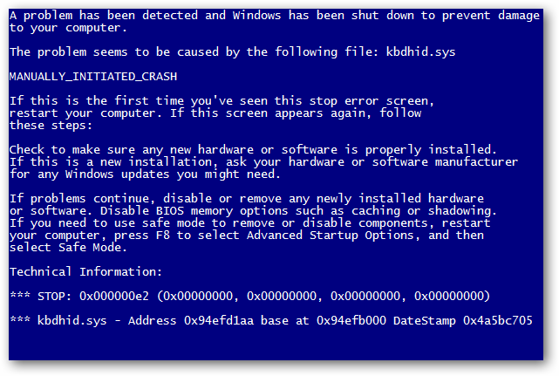
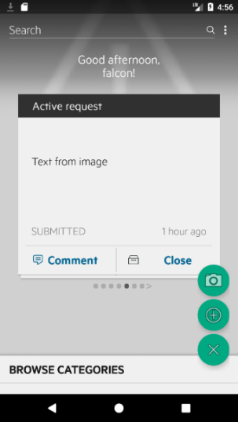
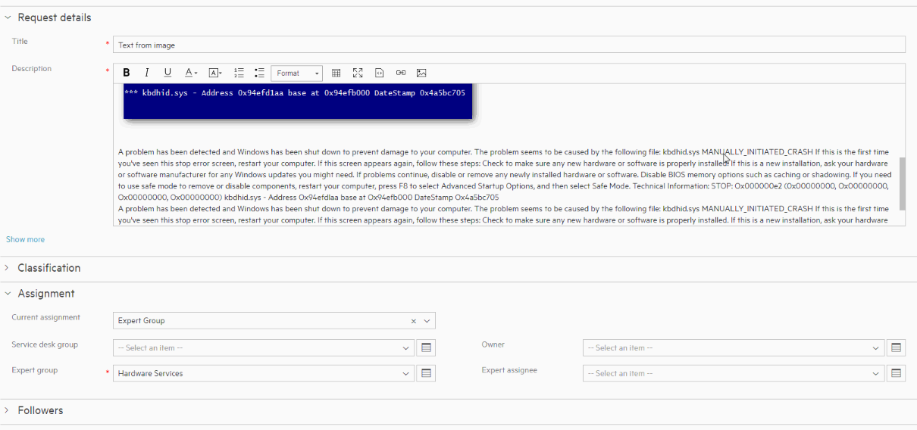
Technology: Smart Ticket Optical Character Recognition (OCR)
Current
End-user
Service Agent
End users can easily post screenshots and images when submitting a support request from their Mobile or via the Web Portal
Smart Ticketing OCR scans the images and provides full text details to the agent
Scanned text is also used for Machine Learning based categorization, assignment, and selection of automated fulfillment offerings

Slide 8
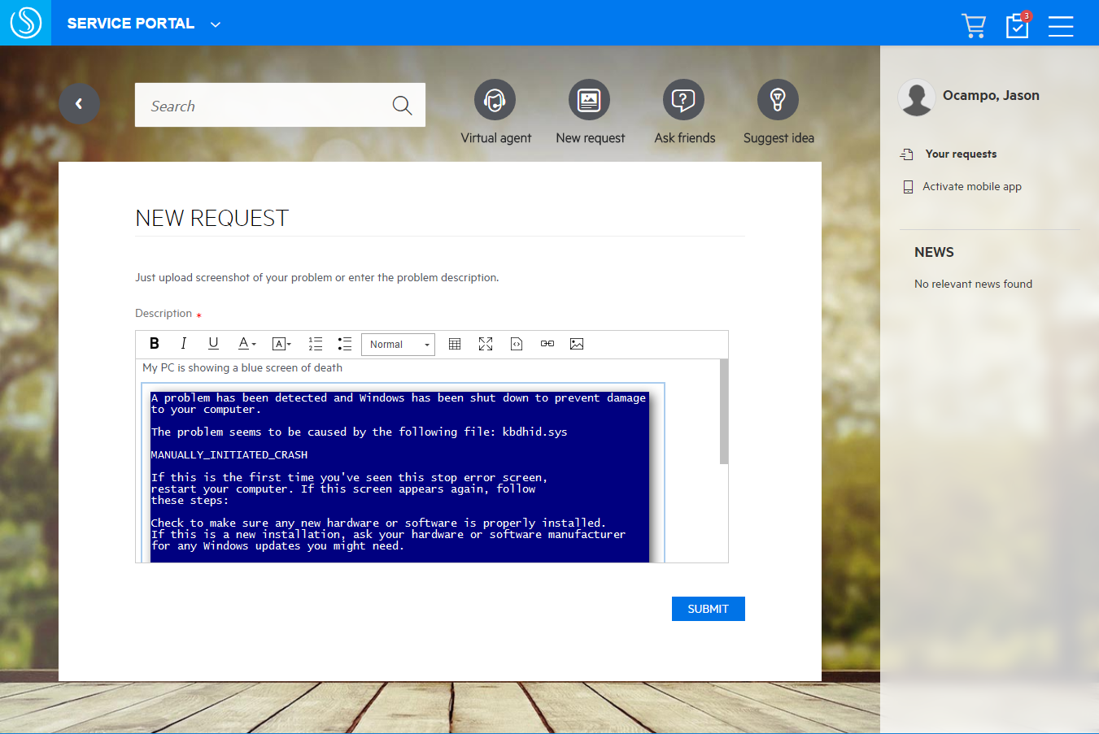
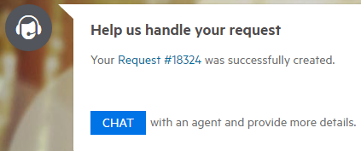
Screenshot: Submit Smart Ticket by End User
Submit a ticket by picture
Outstanding to-do’s are listed by count & accessible here
New requests are started here
Previous requests and their status can be tracked here
Text can be entered manually and images copied & pasted
Once submitted, issues or requests can be easily tracked by their request #

Slide 9
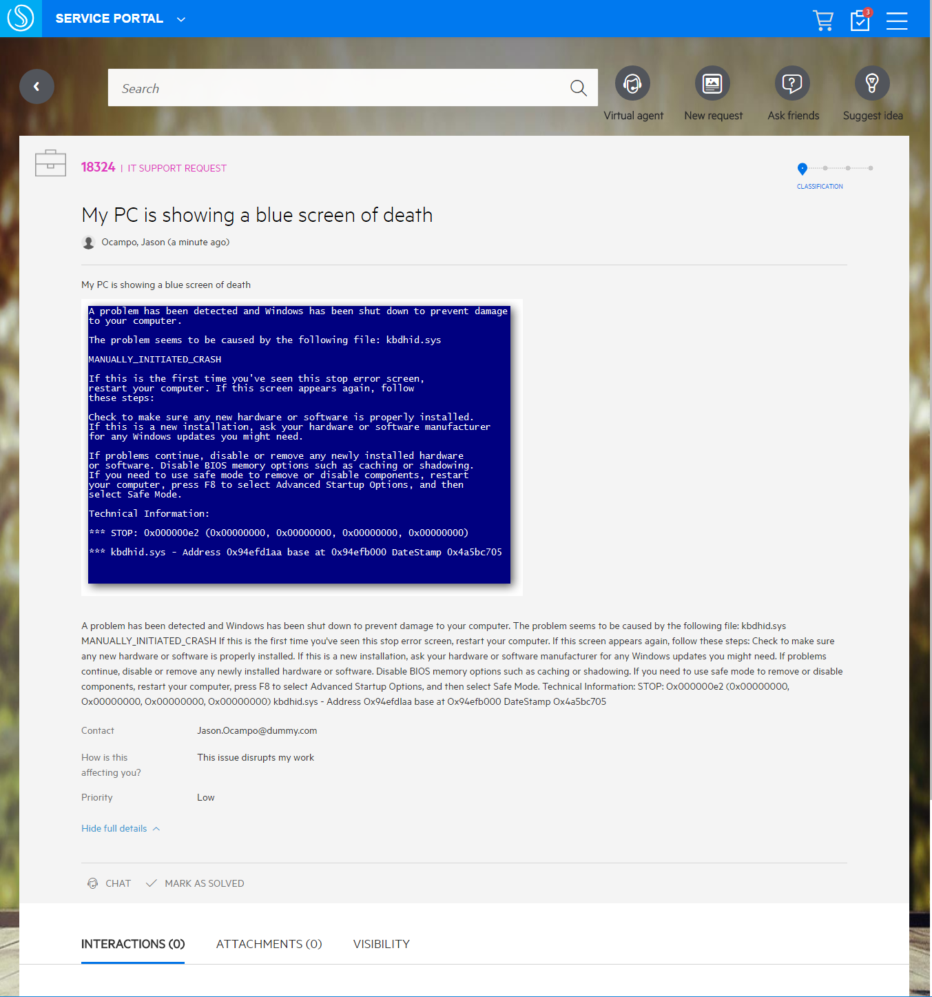
Screenshot: Submit Smart Ticket by End User
Submitted ticket information
Reference number for the just submitted request
Information, both text and screenshots, submitted by the end user on a request or issue
Multiple fields are automatically populated based on the end user request submittal
If the end user comes across a solution, or is no longer impacted, they are able to mark as solved
Kickoff a chat with a Service agent to discuss additional details

Slide 10
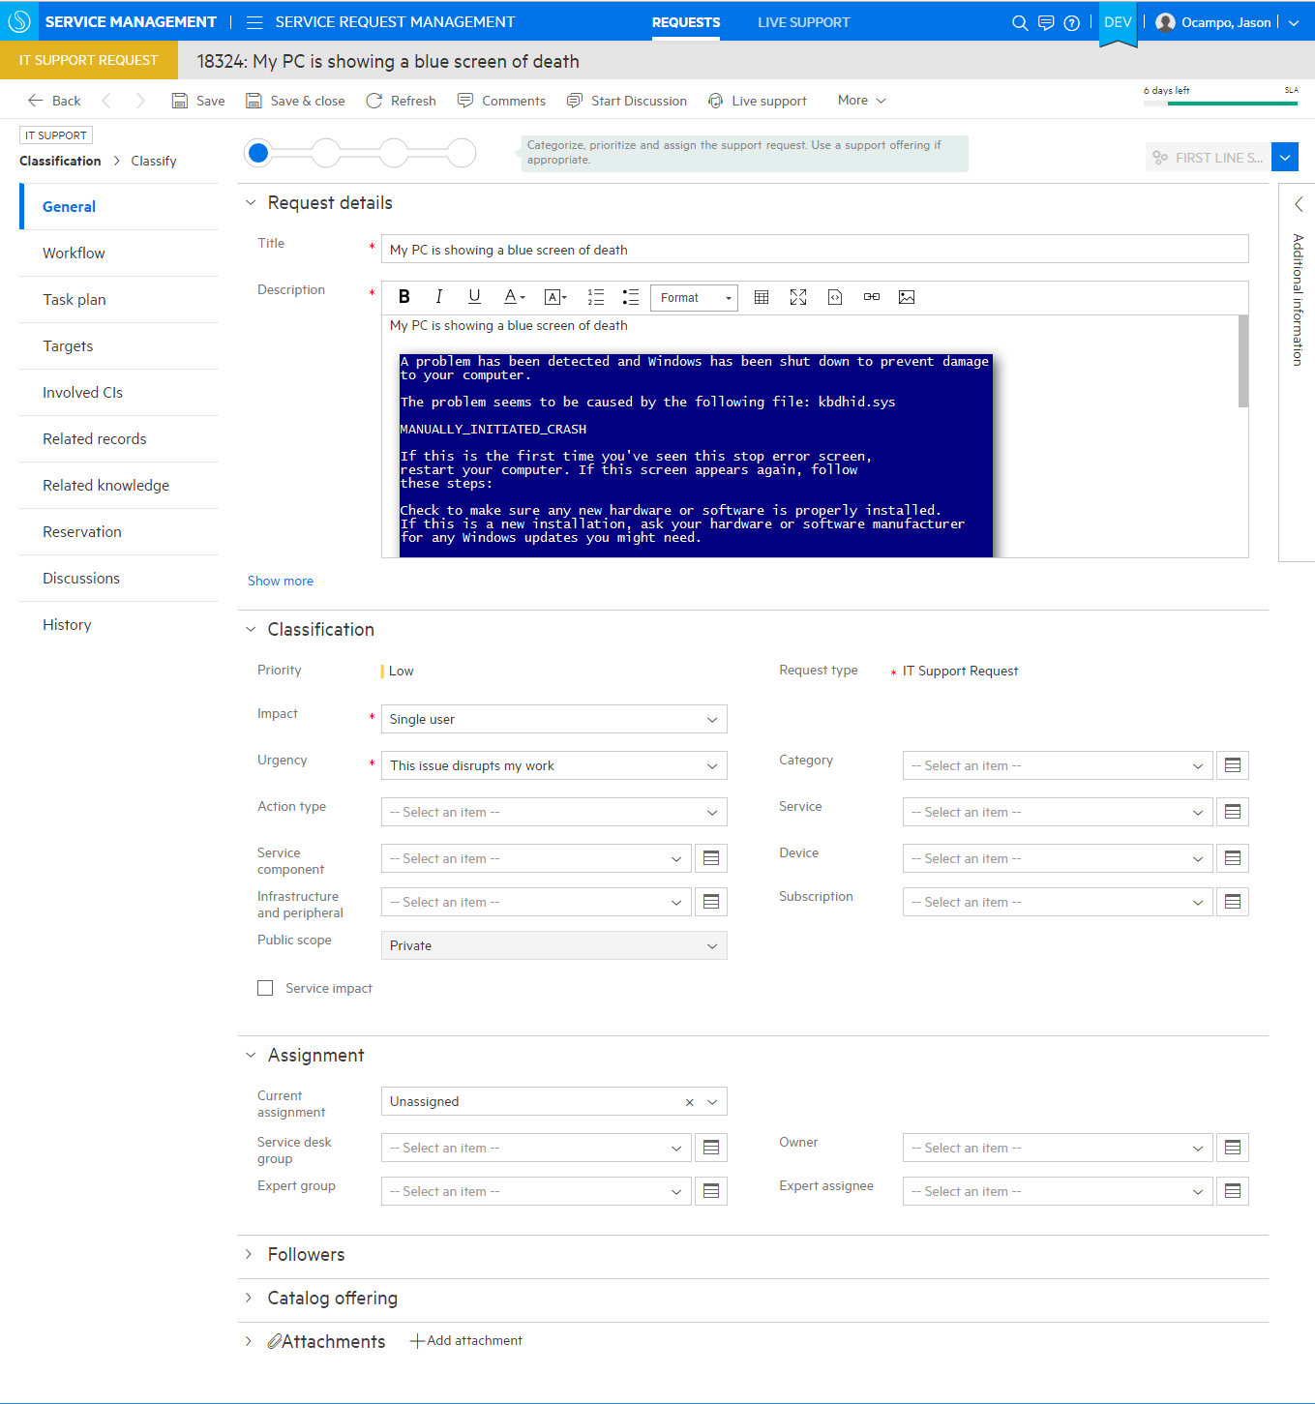
Screenshot: Smart Ticket by Service Agent
Service Agent – Ticket Review
End user submitted information
Classifications pre-populated based on end user inputs
Additional classifications and details can be setup
Set an owner for follow-up
(can be a pre-configured setting)

Slide 11
Video: Smart Ticket
Submit ticket via an image

Slide 12
Description: Smart Email
Ticket creation via email
Create requests from inbound email
Smart email processing can auto-reply with links to suggested solutions
Based on an offering with user options
Email-based
Approvals
ESS request acceptance
Task update and closure
Use Cases
End user logs smart ticket via email

Slide 13
Technology: Smart Email
Inbound email
Create Ticket
Free text and/or image
Interaction #
User
Outbound email
Auto Suggestions
Auto suggestions & action buttons
KM articles, hot news, catalog offerings
Notes:
The Smart Email solution provides the ability for users to interact with Service Manager through email messages. As shown in the diagram above, users can interact with Service Manager by using emails:
When a user sends an email to Service Manager, the email is regarded as an inbound email to the system. Based on the inbound email, SM can create or update a record. If Smart Analytics is enabled, the system automatically categorizes and assigns the record, and then the virtual agent replies to the user with the suggested solutions.
When Service Manager sends an email to a user, the email is regarded as an outbound email from the system. In the outbound email, suggested solutions and action buttons are embedded for the user to perform any appropriate task by replying the email.
Note: if the customer’s system is not licensed for Smart Analytics, Smart Email can still be enabled. Once the ticket is created in SM, and outbound email will be generated but will include no suggested solutions (which is where generated from the virtual agent using Smart Analytics).

Slide 14
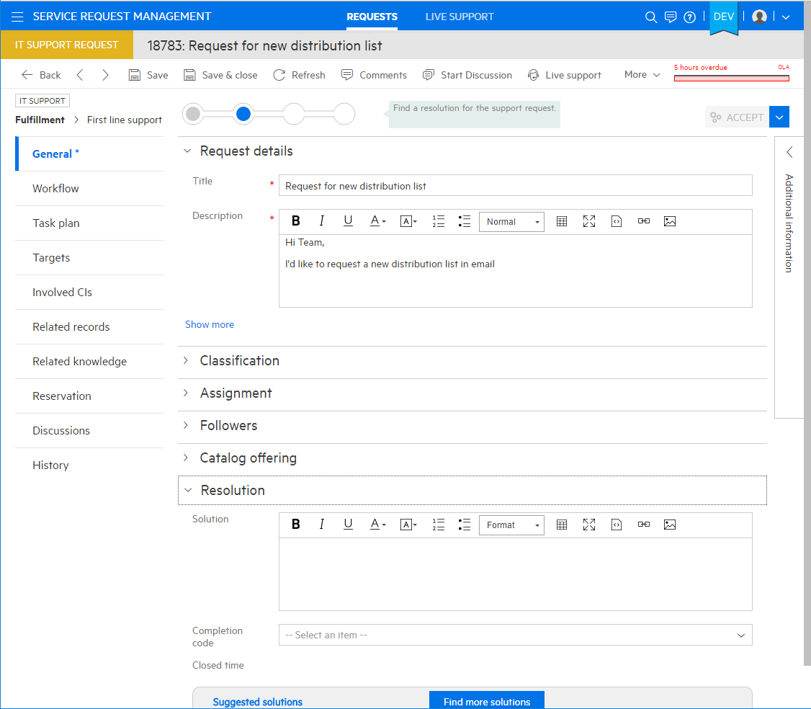
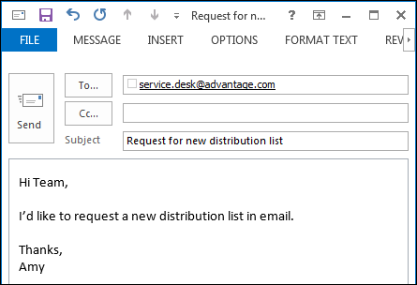
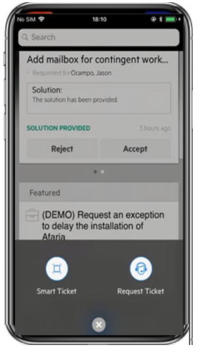
Screenshot: Smart Email by End User
Automated ticketing
24x7 support via virtual agent
Inbound and outbound email communication with service desk agent or virtual agent
Includes action buttons such as accept / reject
Provides knowledge articles, service offerings
Automatically proposes solution

Slide 15
Description: Smart Search
Built-in search tool with advanced cross-module search actions
Global Search
Cross-module search
Selectable sources w/in & outside of SM
Fuzzy search
Filters to narrow down search results
Content-Aware Search
View ticket & search result in same window
Copy solution from search result into working ticket or trigger automated tasks
Use Cases
End user uses self-service to solve own issue
Service agent uses smart search to see suggested solutions to a problem

Slide 16
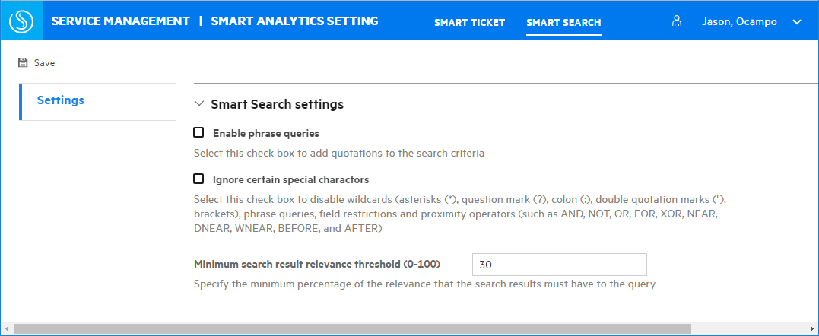
Technology: Smart Search Settings
Enable phrase queries
If you select this check box, Smart Search automatically adds quotations to the search criteria.
If user input contains special character (*,?,“,:,()) or proximity operators, system will not add quotation for search criteria.
Ignore certain special characters
Smart Search interprets special elements as normal characters instead of a query syntax including asterisks (*), question mark (?), colon (:), double quotation marks ("), brackets, boolean, and proximity operators (AND, NOT, OR, EOR, XOR, NEAR, DNEAR, WNEAR, BEFORE, and AFTER)
Minimum search results relevance threshold
Specifies the minimum percentage of the relevance that the search results must have to the query
Db=>settings=>smart search

Slide 17
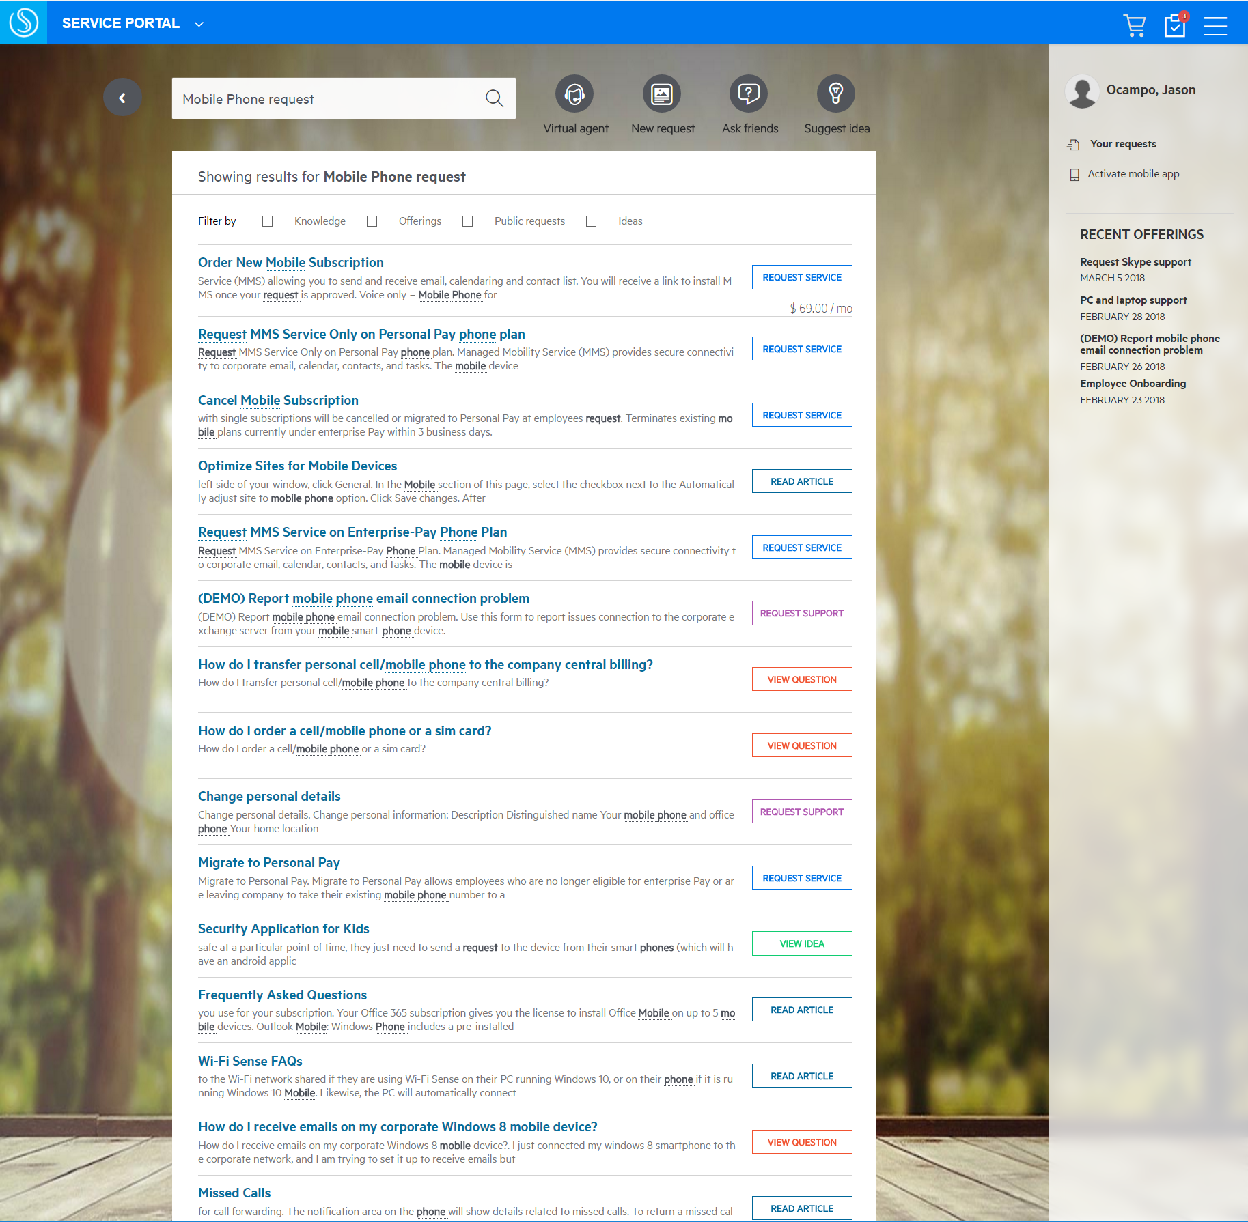
Screenshot: Smart Search by End User
Search across multiple platforms
Full-text search capabilities
Self-Service search of knowledge documents, service catalog, externally published articles
End users comments on knowledge articles, report on knowledge vote, view and usage provide valuable feedback

Slide 18
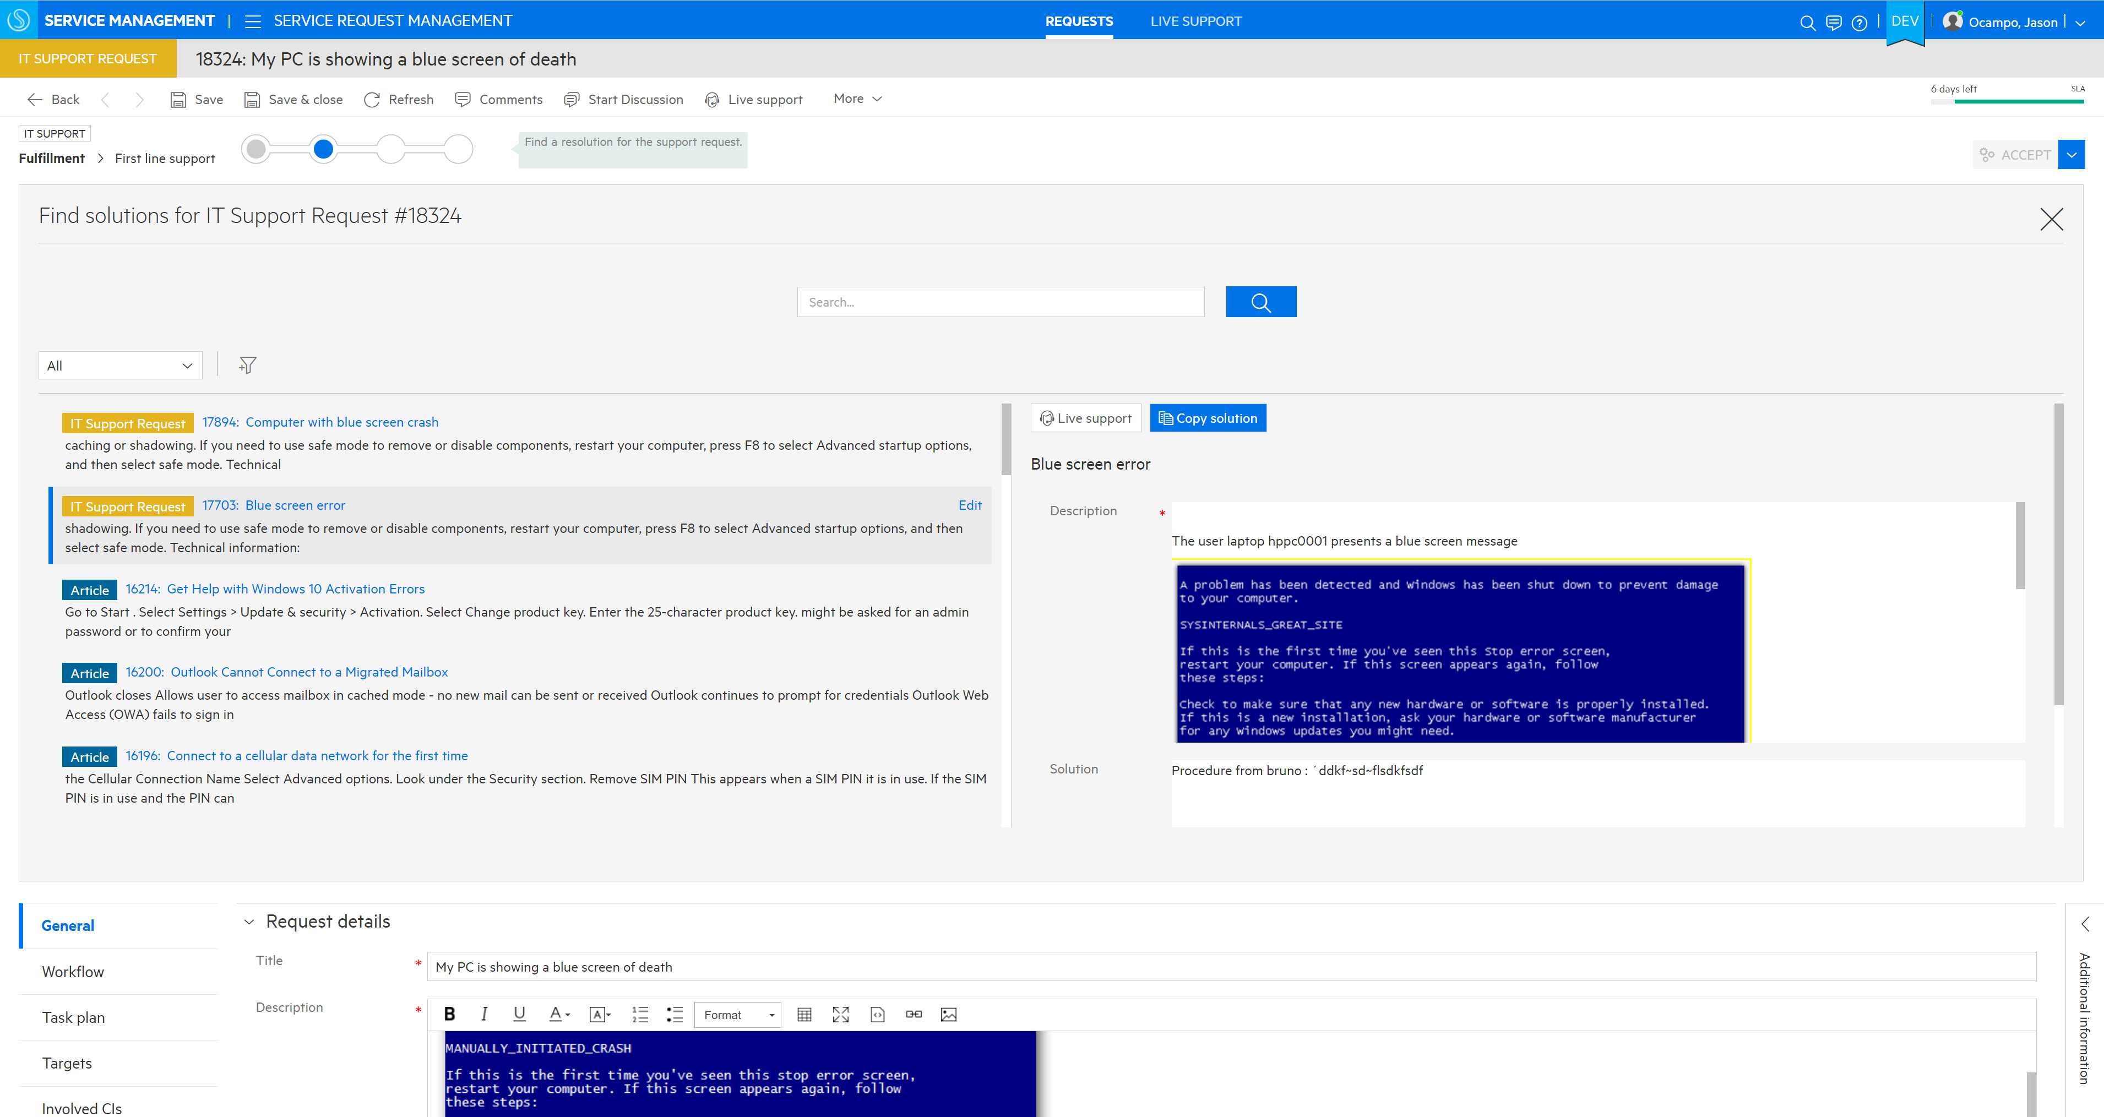
Screenshot: Smart Search by Service Agent
Automatic solution suggestions
IT user search of knowledge documents and service requests, incidents, and problems
Start discussions or provide live support for real time updates on a request
Leverage existing solutions for similar incidents with a click of a button
Use knowledge results to solve current investigations
Knowledge articles relevant to the incident
Convert Service Desk solutions into re-usable knowledge for other agents

Slide 19
Video: Smart Search
Search how to connect to a printer

Slide 20
Description: Virtual Agent & User Chat
Self-service and Agent Chat Options
Self-service (robo) chat
Bot-assisted support
Users guided to appropriate service and support offerings
Agent Chat
Live chat with agent
Manage service specific chat enablement settings and schedules
Dynamic chat work queues
Live support assisted experience – assisted by proactive knowledge
Use Cases
End user asks virtual agent how to order a new phone
Agent starts a chat with end user for more information on an incident

Slide 21
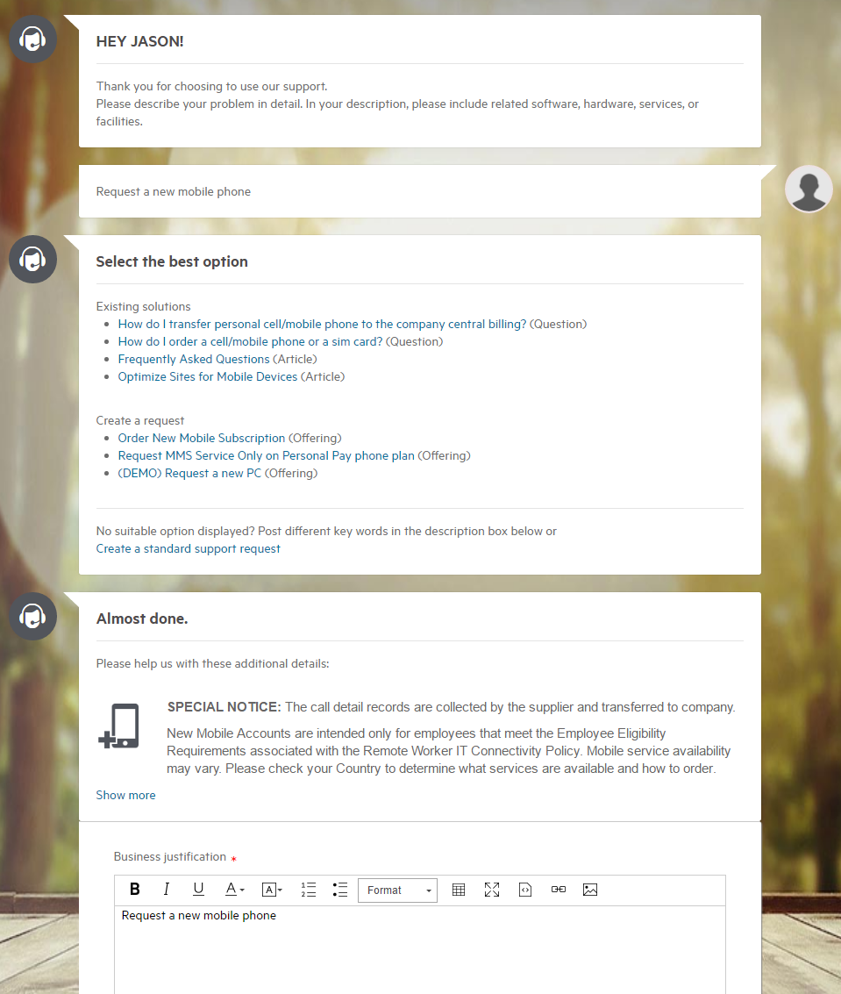
Screenshot: Virtual agent for End User
Automated assistance with integrated live-chat
Self-service (robo)Chat
Automatically suggests News, Articles, Service, and Support Offerings
Past Solution Learning: System ‘learns’ by analyzing similar Resolved requests for support and suggesting Catalog Offerings used to resolve those requests
Update request information for tickets directly through the virtual chat

Slide 22
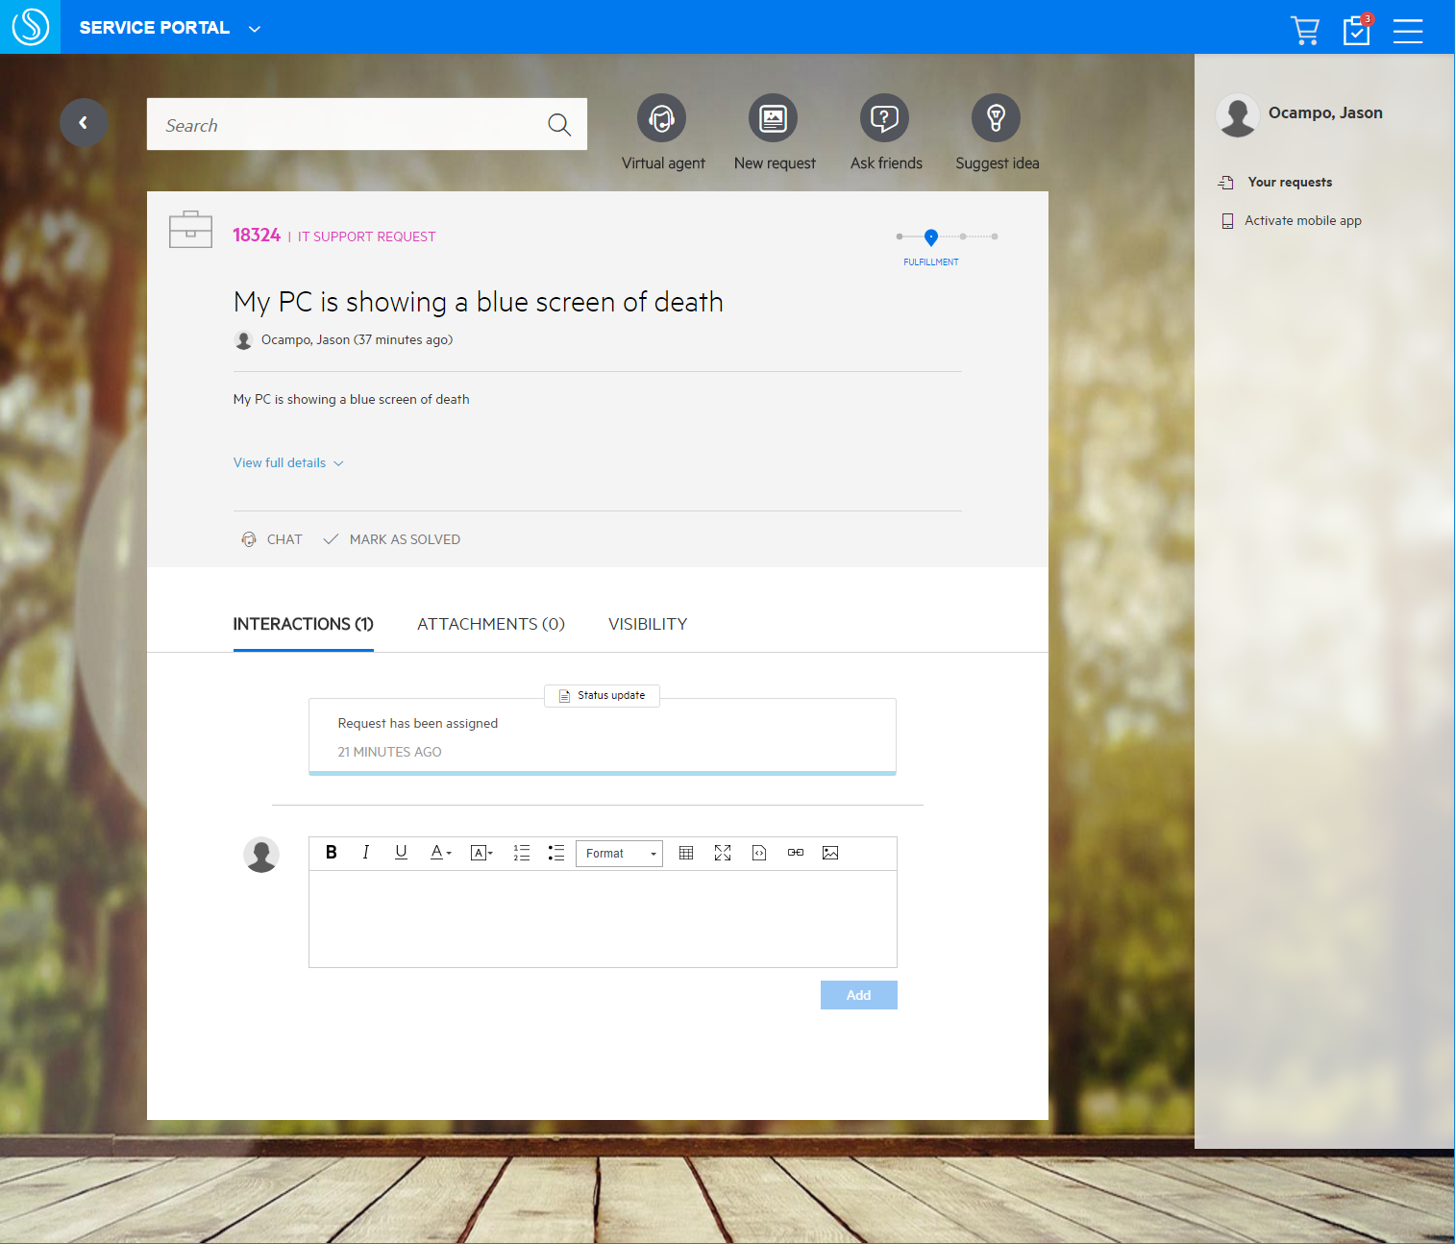
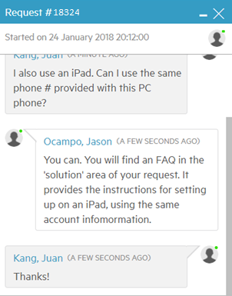
Screenshot: Agent & End-user Live Chat
Leverage chat to capture additional incident information
Live chat with IT Agent
Agent Chat Queues
Manage service specific Chat enablement settings and schedules
Dynamic chat work queues
Live support assisted experience – assisted by proactive knowledge
Notes:
Big data and virtual agent technologies improve the user experience
End user is prompted with solutions and topics based on their search
Then
End User can request chat with live agent
Agent can monitor for chat requests (based on their availability schedule)
End user can chat with a virtual agent
24 x 7 support
Proposes knowledge articles, catalog offerings, hot news
Powered by Smart Analytics
Remote support using MS Skype for business
Introduces a #menu command to present useful information and automation
Top 3 questions
Top 3 hot news items
Update account information
End user can also chat with live agent

Slide 23
Video: Virtual Agent & User Chat
Search on mobile email issue

Slide 24
Description: Hot Topic Analytics
Display patterns in structured and unstructured data
Display related topic terms and record counts
Configuration flexibility
Document differentiation (search, survey, requests)
Free up resources and time
Display impact of potential problems based on cluster size of related incidents
Looks beyond incidents
Use Cases
Service agent creates a KM article
Service agent creates problem via multiple incident tickets

Slide 25
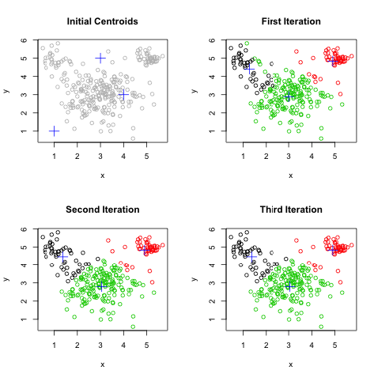
Technology: Hot Topic Analytics
Algorithm for analytics
1
2
Bayesian algorithm
Unsupervised Machine Learning
Time sensitive analytics
Initial index
Put seeds of theme
Bayesian Logic – using the knowledge of prior events to predict future events
https://whatis.techtarget.com/definition/Bayesian-logic
3
4
Cluster
Minor adjust

Slide 26
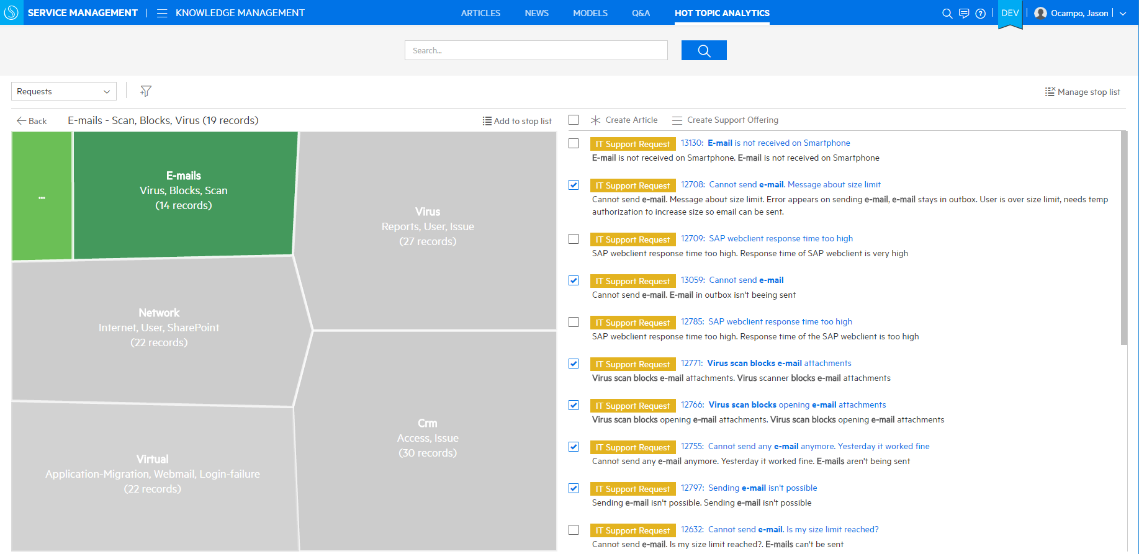
Screenshot: Service Agent uses Hot Topic Analytics
Create new articles or support offerings
Configure stop word lists
Analyze hot topics within user portal search, social Q&A, requests, incidents, and survey results
Create new knowledge articles to resolve known support requests
Shows analysis of important interest areas
Displays grouped topics and record counts
Notes:
Hot Topic Analytics
Analyzing a huge amount of data takes a lot of time, preventing IT organizations to be more proactive and to identify potential incidents before they impact service availability. As a result, IT is really struggling to put a proactive Problem Management process in place.
“Hot Topic Analytics” closes this gap. Using Hot Topics Analytics, Problem Managers get a clustered view of recurring themes hidden in the huge quantities of unstructured data. Hot Topic Analytics structures this data and provides incident title and description text, including the option to filter and zoom into smaller sets of data as needed.
Turn data into answers for automated incident remediation
Frees up resources and time:
Problem hunting to reduce time to problem isolation
Displays impact of potential problems based on cluster size of related incidents:
Determines patterns in thousands of incidents for faster problem isolation
Become proactive:
Discover incident trends based on analysis of unstructured data for proactive management
Look beyond incidents:
Also works with other modules such as Interaction, Change and Knowledge Management
Turn unstructured data into actions you specify
In the out-of-box system, Hot Topic Analytics is available in the Service Desk, Incident Management, and Problem Management modules. If you want to use Hot Topic Analytics to help you identify hot topics in other modules such as Change Management, you can tailor your Service Manager system.
There are step-by-step instructions for extending HTA to other modules in the Service Manager Help Center, and the Smart Analytics Administrator and User Guide.
Can be configured for multiple data sources (changes, knowledge article feedback, etc)
Can be configured for multiple outcomes (create incident, create article, etc)

Slide 27
Video: Hot Topic Analytics
Create Problem Ticket from incidents
Create Support Offering
Create Article from User Searches

Slide 28
Description: Change Analytics
Overview & Use Cases
“Insights and suggestions to improve change management”
Define goals to help drive organization change
Automate smartly – the Change automation KPI suggests most popular models to target for automation
View the Success analysis, risk statistic, best 3 and worst 3 changes for similar changes
Time Period Breach Driven Process
Use Cases
Track success rate, use of standard change and change automation
Track KPI trends via monthly reports

Slide 29
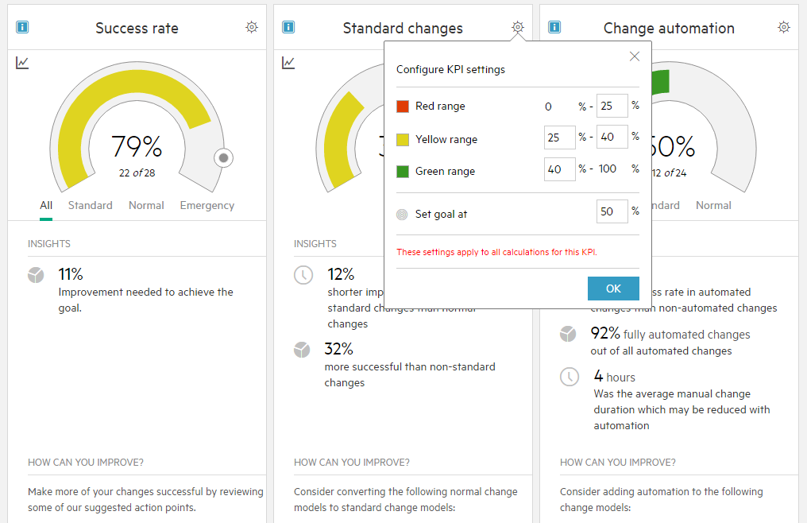
Screenshot: Change Analytics
Insights and suggestions to improve change management
Big data predictive analytics change owners to make process improvements
Analytics identify areas that can benefit from standard modeling and automation as means to reduce risk, increase success rates, and reduce implementation times
Insights
Recommended improvements

Slide 30
Description: Fast CI Detection
Analyze, detect and associate CIs automatically
Highlight CIs within rich text to identify automatically detected items
Real time detection
Use Cases
Create a new incident that links a CI within the incident description

Slide 31
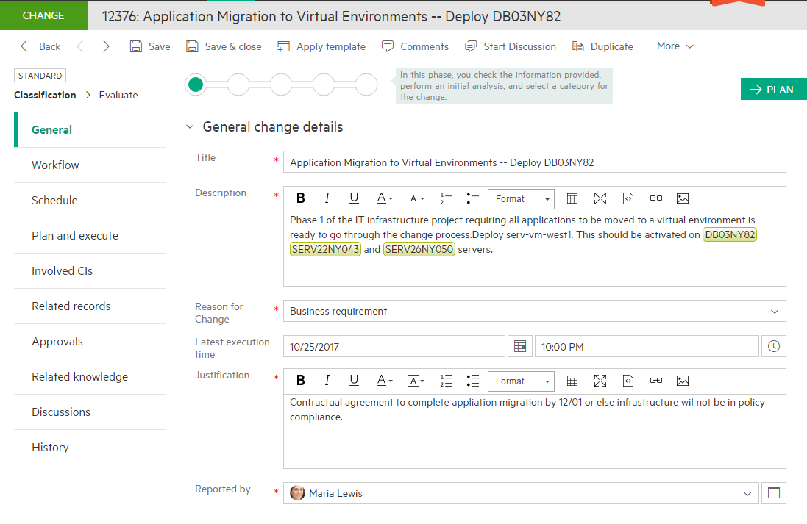
Screenshot: Fast CI Detection
Analyzes rich text content and automatically finds and highlights CIs that appear in the text
Detected CIs are automatically added to the involved CIs section of the record
Notes:
Quickly associate CIs with a change by typing/pasting CI descriptions into the Change and Incident description
Simply typing some identifying text (such as a CI IP address, or name) will locate the CI record and offer to make a link association to that record from the current Change or Incident
This is very useful in cases where planning involves large number of Cis, and a user may enter their association by copy/pasting from a planning document or spreadsheet

Slide 32
Description: Service Portal & Catalog
Engaging user experience via a modern self-service portal
Intelligent knowledge delivery
Chat/Collaboration
Mobile Device Support
Use Cases
End user can view most commonly used catalog offerings & latest offerings & requests from other users
End user can check status of their own outstanding requests
Create new offering from an aggregated catalog

Slide 33
Screenshot: Service Portal & Catalog
Track requests via shopping cart
An engaging user experience, any place, any time
Collaborate with peers
Submit a new idea or update
Check status on incident or request
Powerful search options
Native mobile app
News alerts on active outages
Personalized background and color scheme
Latest offerings and requests
Catalog offerings
Check the latest ideas and see community reactions

Slide 34
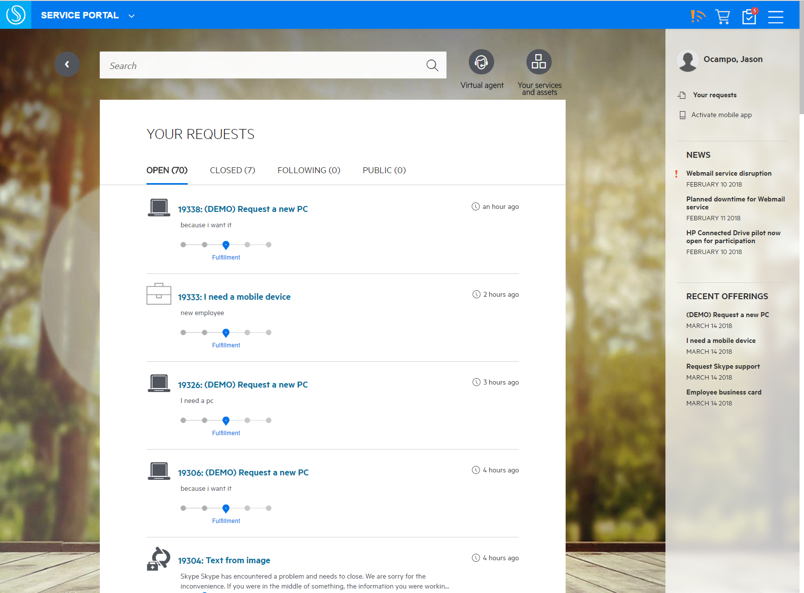
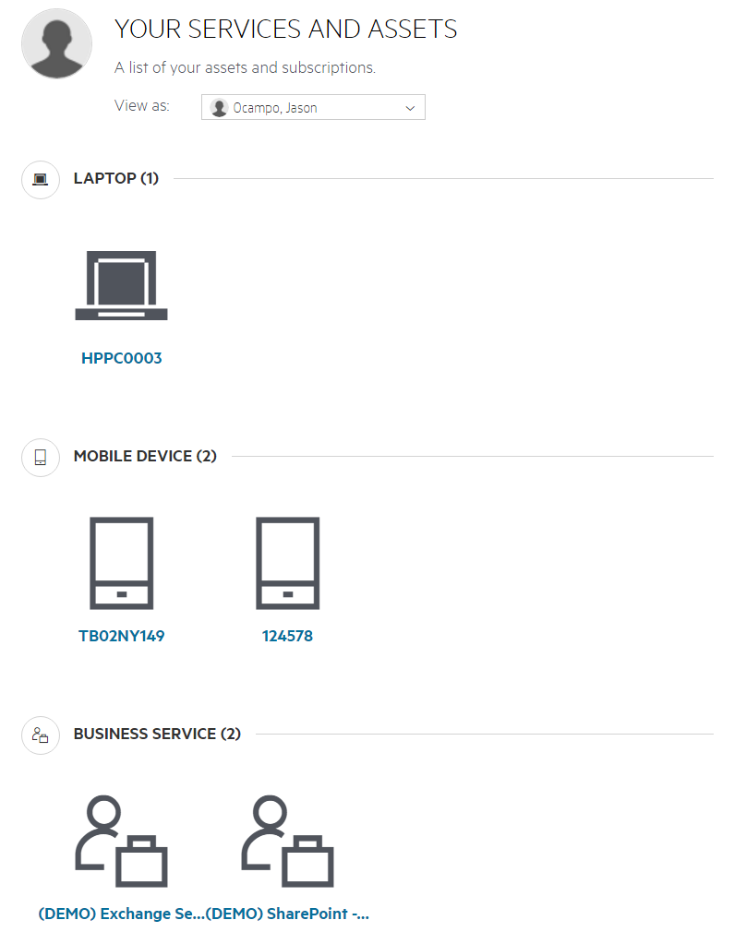
Screenshot: Service Portal & Catalog
Review Your Outstanding Requests and Services/Assets
View all outstanding services and assets
Request status and # of requests in that state
Quick link to request and see additional status information on request
Drill down to see additional asset information

Slide 35
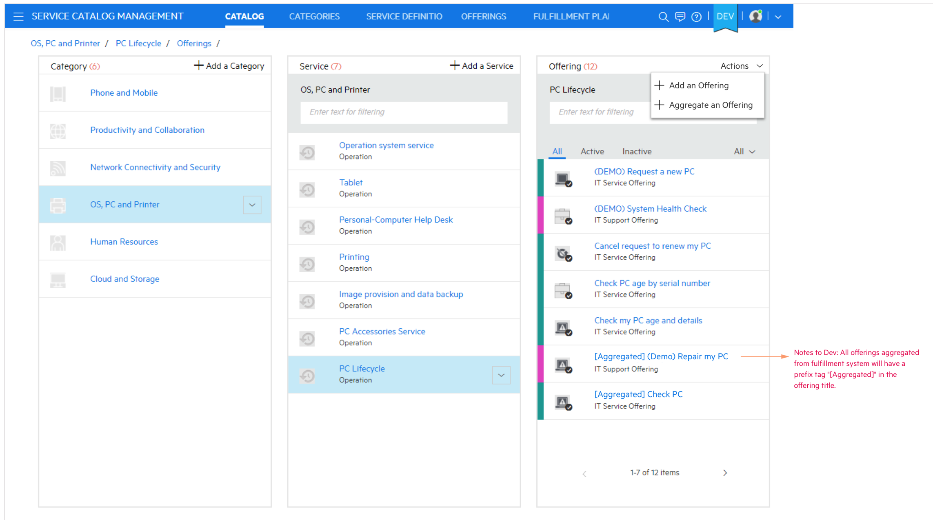
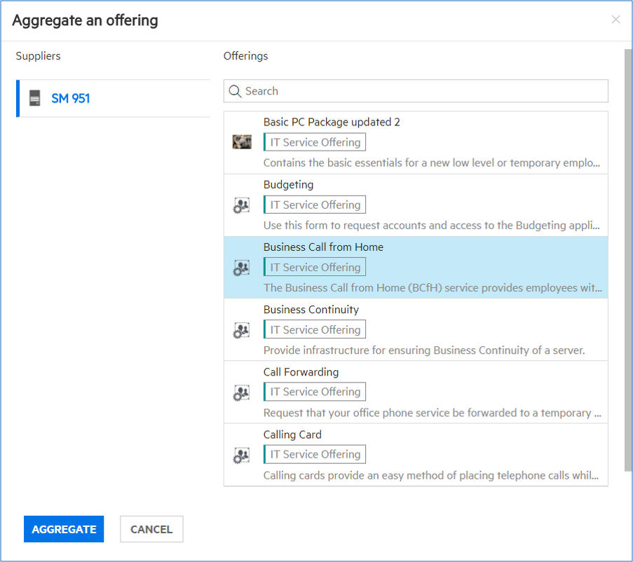
Screenshot: Catalog Aggregation – Service Governance
External fulfillment systems
Create a new offering from an aggregated system
Administrators can search, select content, and aggregate catalog offerings from external fulfillment systems
Unified point for requesting, tracking and monitoring
End user can request aggregated offerings from catalog & track status of requests
Unified point for requesting, tracking and monitoring
Automated, ongoing synchronization for catalog offerings
Notes:
Categorization continues to be done in the SMAX Catalog
Entitlements are managed in SMAX, and will not be aggregated/mapped into X
Complex dynamic options behavior and Complex Pricing are managed in SMAX
Bulk aggregation mode (ability to aggregate more than one offering) is not supported at this time
User options support: Table lookup, radio buttons and drop down lists are not yet supported in SMAX
Actions in SM request are not supported in X: For example SM actions like end user accept or reject solution are not supported in X
Aggregation of bundled items to X is not supported
Initial release will provide integration to MF Service Manager. Additional adapters and SDK are planned for later as part of roadmap.

Slide 36
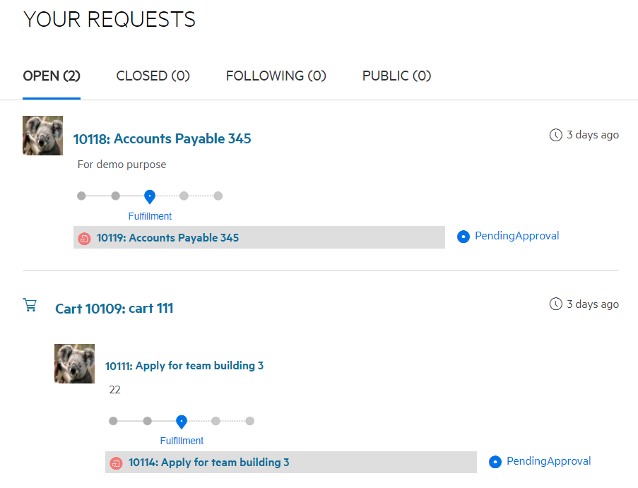
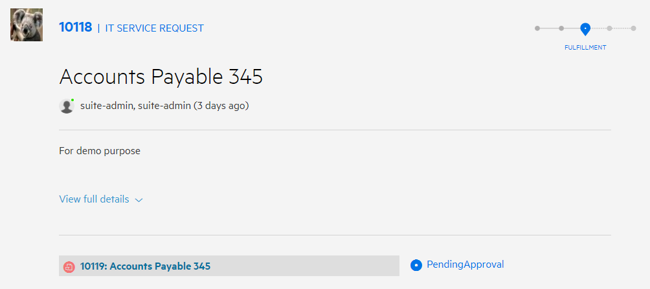
Screenshot: Catalog Aggregation
Request an aggregated offering
Manage and track requests (including aggregated offerings)
Portal will map fulfillment systems status
Status and solution of external fulfillment request is auto-synchronized to related external task
Portal request tracking provides information related to fulfillment tasks tied to aggregated offerings
Notes:
Categorization continues to be done in the SMAX Catalog
Entitlements are managed in SMAX, and will not be aggregated/mapped into X
Complex dynamic options behavior and Complex Pricing are managed in SMAX
Bulk aggregation mode (ability to aggregate more than one offering) is not supported at this time
User options support: Table lookup, radio buttons and drop down lists are not yet supported in SMAX
Actions in SM request are not supported in X: For example SM actions like end user accept or reject solution are not supported in X
Aggregation of bundled items to X is not supported

Slide 37


Description: Native Mobile Apps
Mobile apps allow the same capabilities found on the Web-based Service Portal
Android mobile app available on Play Store
iOS mobile app available on Apple app store, compatible with iOS 10 & 11
Use Cases
End user can perform any tasks on the Service Portal via an Android or Apple smart phone

Slide 38
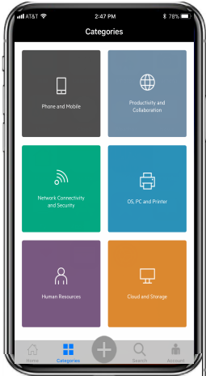
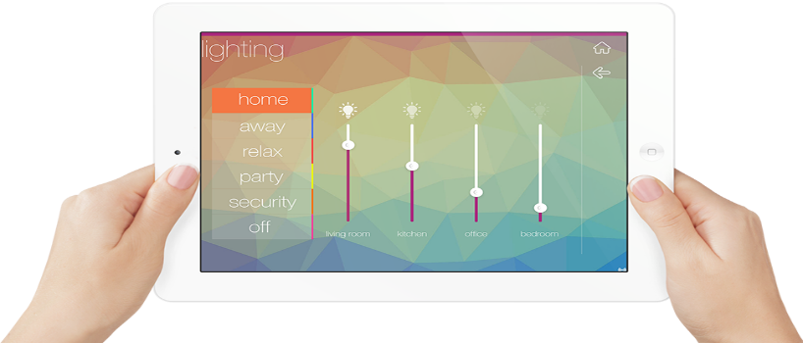
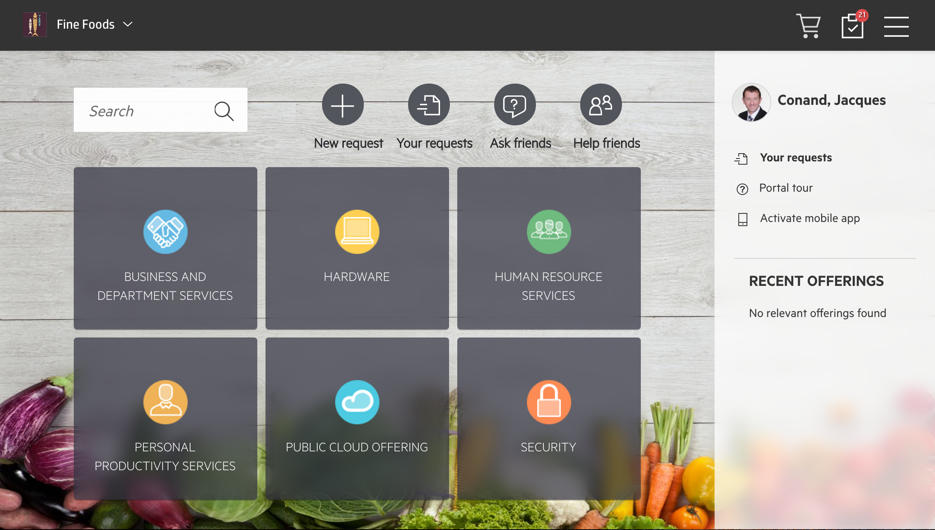
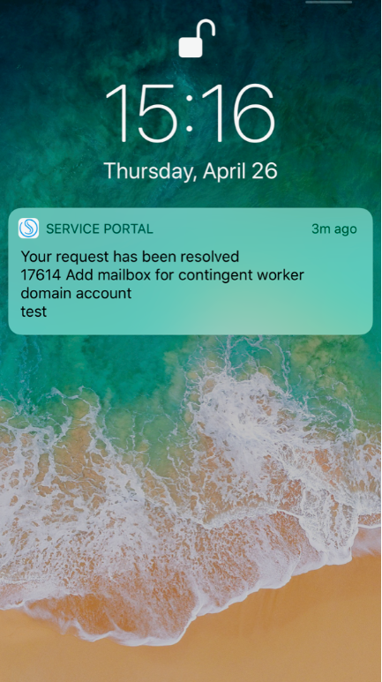
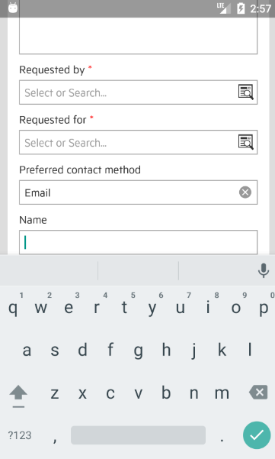
Screenshot: Native mobile apps
Responsive UX design using HTML5
View currently open requests
Browse the catalog, quick pick from the most popular
Notifications displayed when app not opened, iPhone lock screen and notification history
Search for offerings, articles and view mobile-optimized knowledge articles
Native dynamic form replaces webview forms, improving performance and enhancing layout
Respond instantly when an agent responds to a ticket
Create new requests or proactively approve existing requests

Slide 39
Description: Collaboration
Bring work you’re already doing inline w/the context of the conversations you’re already having
Collaboration
People
Process
Tools
Context
Reuse of remediation
Intelligence
Cross-Domain
Complementary
Value-Add
Use Cases
Multiple teams and systems collaborate to troubleshoot & solve a system issue
Notes:
ChatOps’ collaboration capabilities empower cross-functional teams to self-organize quickly and effectively. With ChatOps, these teams have greater awareness, transparency, and trust. ChatOps also enhances team sharing and learning while shortening feedback loops.
ChatOps improves people-and-machine collaboration by automating tasks. ChatBots, or ‘bots’, are at the core of ChatOps. ChatBots are smart and are programmed to do many tasks that connect people with the information they need. ChatBots can gather information, leverage analytics and machine learning, or even automate the response to incident remediation.
Micro Focus provides smart open-source ChatBots and collaboration interfaces for all IT operations management suites and popular chat platforms.

Slide 40
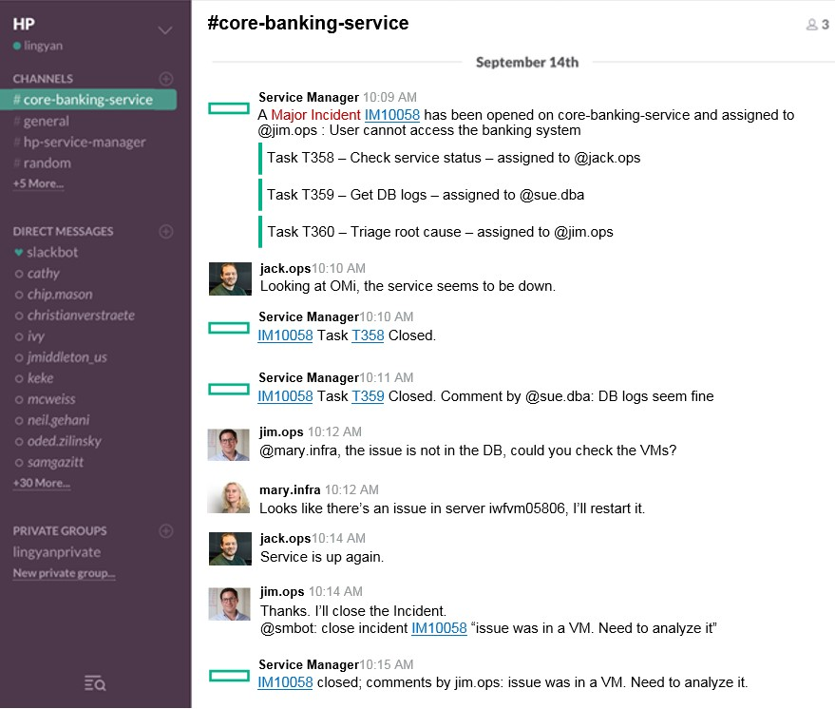
Screenshot: Collaboration
ChatOps
Virtual war rooms
Chat robots are part of the collaboration
Chat flow
Multiple people can collaborate to solve an issue
Notes:
ChatOps is one of the leading innovations in SMA. It provides a virtual war room to efficiently improve IT agent collaboration.
ChatOps helps to solve issues faster in an efficient transparent way using real-time chat
- Assemble the right people, right tools & data at right time
- Cross-boundary collaboration of people, process, tools and automation
- Resolve once, re-use next time … automatically document entire incident resolutions in a transparent, repeatable fashion

Slide 41
Description: Surveys
Measure end user satisfaction at the end of each Service Management process
Multiple survey templates to support different SM processes
Customization capabilities to address business needs of an organization
Automatically or manually poll users
Analyze results via Hot Topic Analytics and reporting
Use Cases
Service agent creates a new survey to garner end user satisfaction on new catalog deployment
End user is notified of survey and completes it
Service agent is able to view reporting and analytics on the survey (once completed)

Slide 42
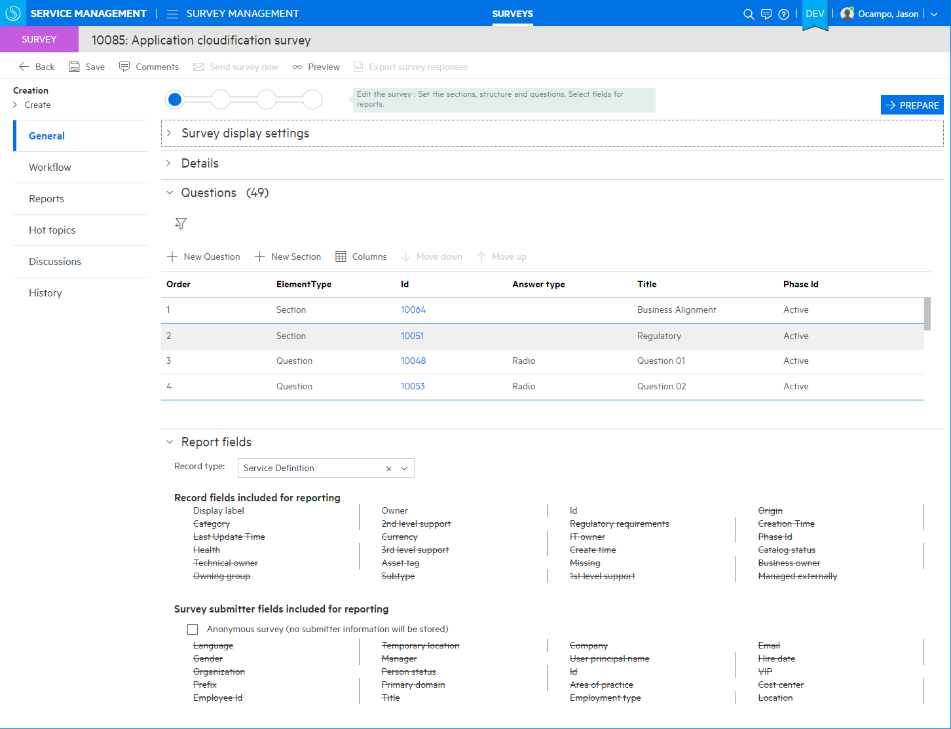
Screenshot: Create Survey for End User
Define surveys related to any process (Satisfaction surveys for Service, Support, Asset model, Post Change success survey, etc.)
Easily configure question text and type and assign IDs for future analytics
Pre-defined fields allow for quick and easy survey setup including one-click anonymous configuration
Notes:
Create, publish and ANALYZE surveys

Slide 43
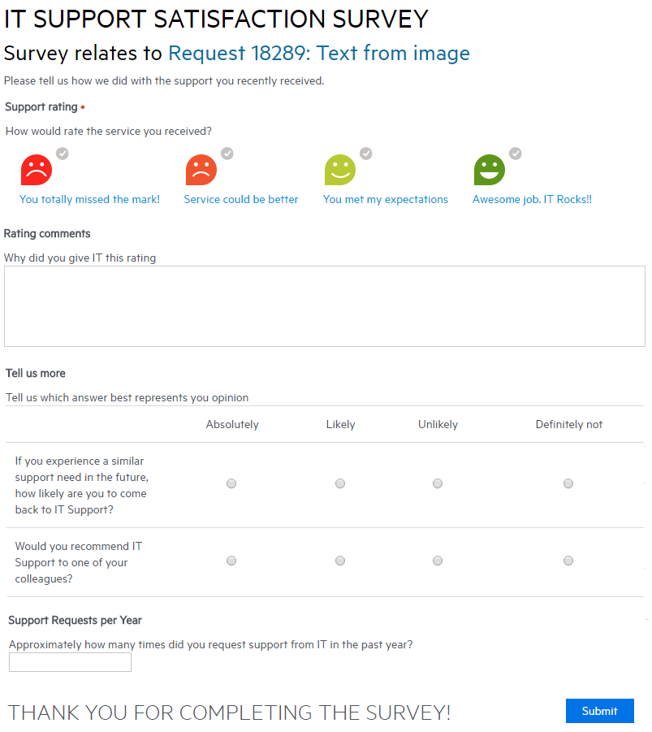
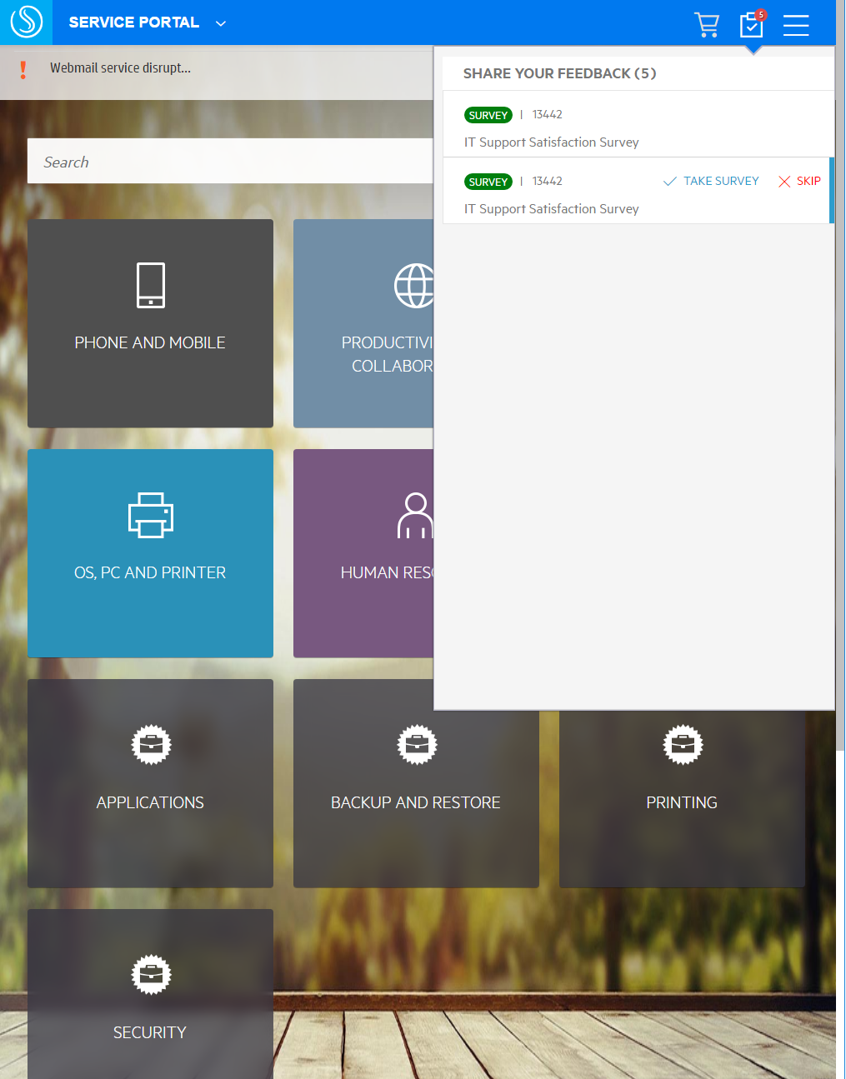
Screenshot: Survey taken by End User
Simple, relatable icons for easy selection process
Collect responses effectively – friendly formats designed to increase user response rates
Multiple options for gathering data via paragraph text, checkboxes, and numerical inputs
Simple submission collects and stores all related user data for larger reporting and analytics
Notes:
Create, publish and ANALYZE surveys

Slide 44
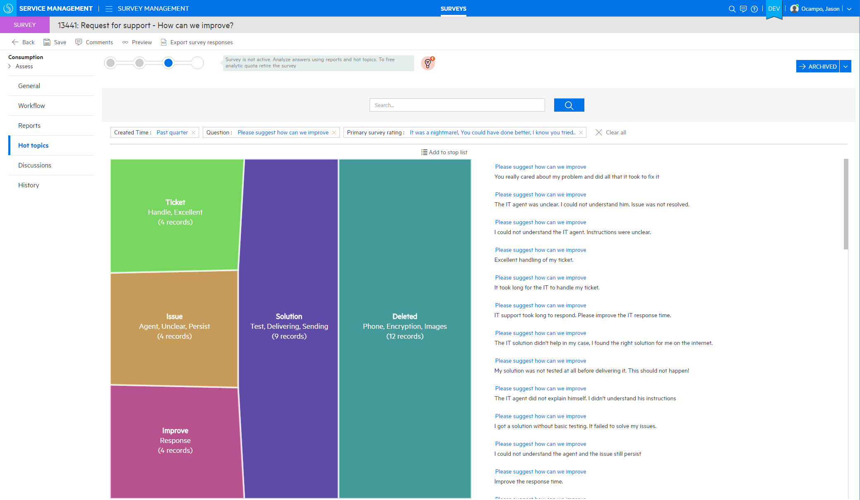
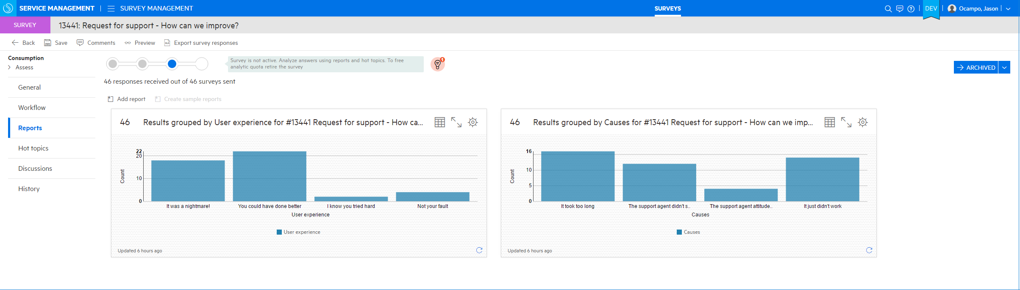
Screenshot: Survey Analytics
Easy navigation from survey creation to status reports to analytics
Big data analytics – hot topic analysis of responses
Full report and dashboard capabilities
Notes:
Create, publish and ANALYZE surveys

Slide 45
Description: IT News
Push self-service targeted news on both the web and mobile apps
Separate news lifecycles
Segment news by location or group entitlements
See news relevant to service and support context
Use Cases
Create article about new functionality for specific functional group

Slide 46
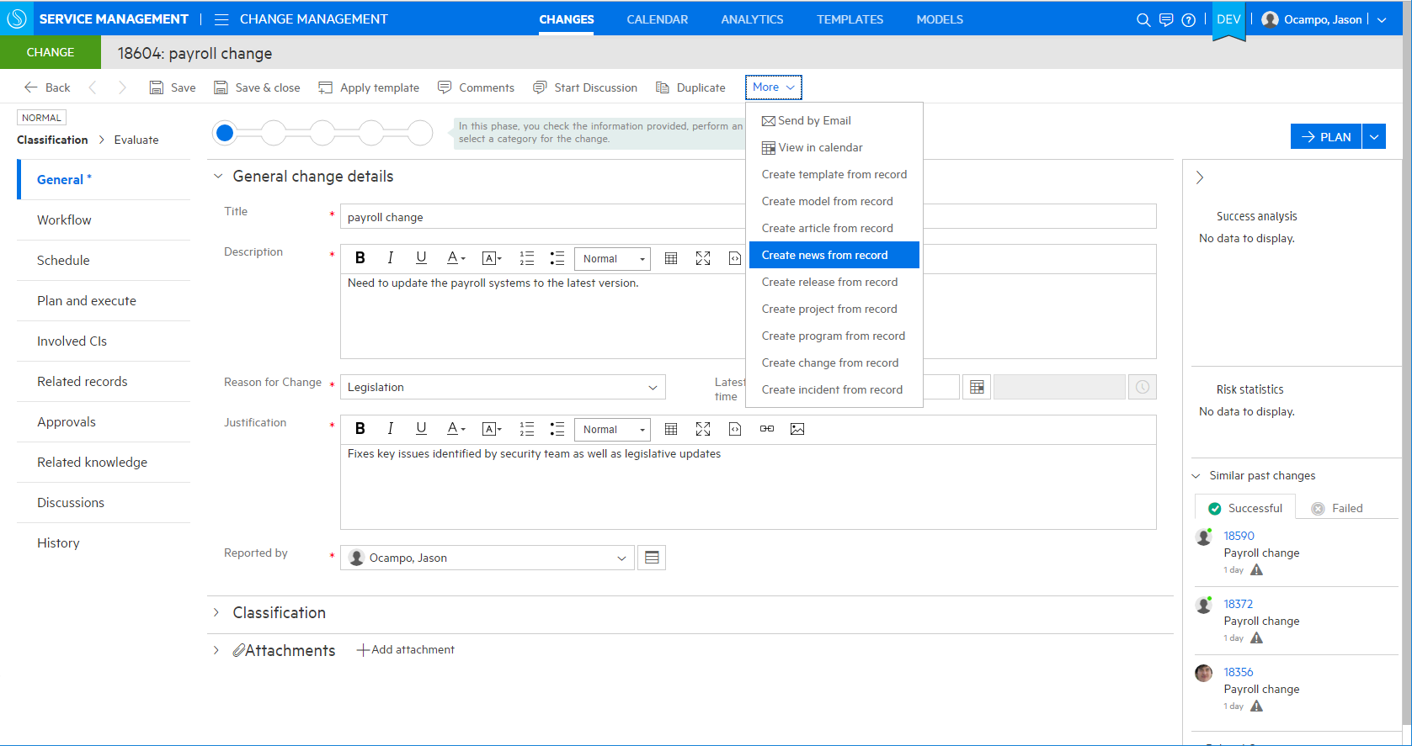
Screenshot: IT News Creation
How service agents can create news
Publish news from Incident, Change, or Service Catalog
Notes:
News can be public or “tailored” i.e. directed to specific functional groups or locations
News has it’s own lifecycle workflow

Slide 47
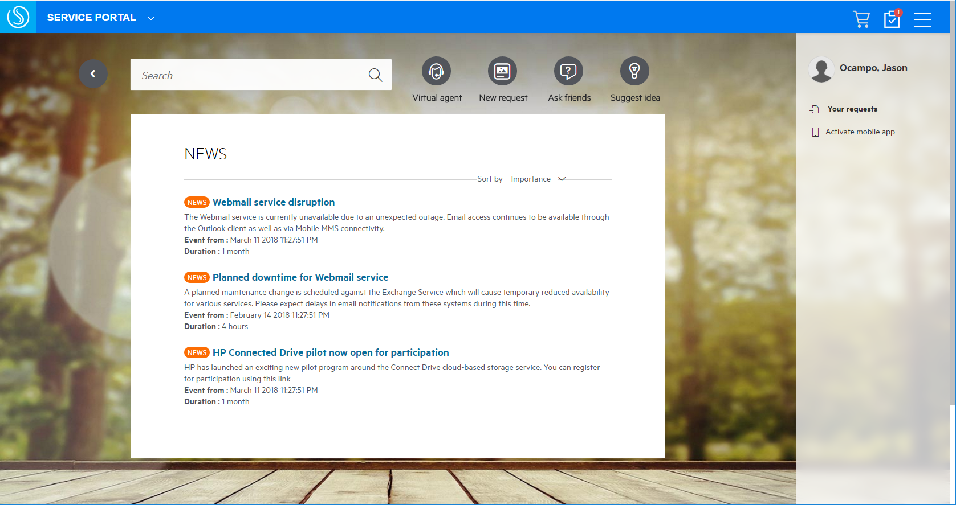
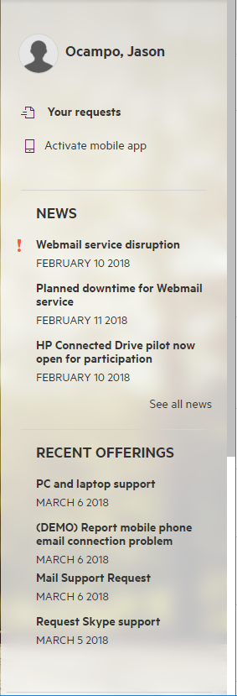
Screenshot: IT News for End Users
Functionality for business and service desk users
Segment news by location/group entitlements
Self-service targeted news
Push news to users via Self-Service Portal on web and mobile
Notes:
News can be public or “tailored” i.e. directed to specific functional groups or locations
News has it’s own lifecycle workflow

Slide 48
Description: Public/Social Requests
Use the power of social engagement for requests and to solve issues
Define multiple types of publicly accessible requests
Easily track recently open/closed requests over multiple weeks
Email integration for notifications on new comments and/or solution updates
Use Cases
End users can collaborate to identify, fix and communicate details on a support issue
Notes:
Smart Ticket
The Smart Ticket capability enables users to submit self-service support requests in a very simple way.
With HPE Service Manager Smart Analytics in place, there is no need for the user to fill in any fields when submitting a ticket. All the user needs to do is to take a screenshot of the error message, attach it to the ticket, and click the “submit” button. The Optical Character Recognition (OCR) feature of Smart Analytics takes the text from the image and adds it into the Description of the interaction. This is known as the “unstructured data”.
Smart Ticket then takes that unstructured data and proposes the ticket classification based upon its learning of past interactions, setting the Category, Subcategory, Area and Affected Service.
Another option for the user is to just type in a couple of text lines to describe the error in natural language. All of the ticket details are completed automatically in the backend.
A superior user experience, better call routing, quicker resolution time
Automated ticketing for a superior End User experience:
Image based ticketing – just attach a picture
Takes self-service ticketing to the next level of simplification
Saves the end user time, effort and guess work
Faster and more accurate categorization, more accurate ticket routing.
IT Agent is more efficient as classification of interaction is proposed based off Smart Analytics learning from past tickets and therefore more accurate.
Via Web Client, an IT Agent can submit a Smart Ticket by just typing a Description, clicking Smart Classification and then Continue.

Slide 49
Technology: Public/Social requests
Shared visibility
Enable expanded visibility for requests for specific offerings. For example:
Support for Shared Printer issues may be visible by users in the same location
Application Performance issues may be visible by users in the same organization
Shared impact
When users report an issue, they are presented with similar visible support requests
Instead of opening a new ticket, a user may sign onto a public/social ticket, add comments and receive tracking notification
Social engagement
Use the power of the crowd to collect potential solutions
Leverage solved requests as knowledge
Help! Printer is jammed
Is the Payroll portal is down?
User A
Location Shared Device
Organization Shared Application
User B
User C
Me too! I have the same problem
I just got help unjamming the printer. Try it now ☺
Notes:
Customer can define for any offering if it’s can generate public requests. Values are Always (all requests for the offering are public), Never (no request for this offering is public) or user-defined. For Always and user defined, the default public scope is determined by the offering default values. For user-defined, the user can change the values during the request opening procedure.
Agents can set the values on the request manually.
Users can find open or recently closed public requests (up to 3 weeks of opening) when searching ESS.
Users will have a list/tab of public requests in the request list page
Users can register to track a public request – they will have a tab in request list page to show all tracked requests
Support agent can manually add users to the list of followers of the request
Users will receive comment and solution updates on their tracked requests and can add their own comments from ESS or by email integration
The requestor will be notified on new comments from other end users and can mark the comment (from mail and UI) as the comment that was the solution to his issue.

Slide 50
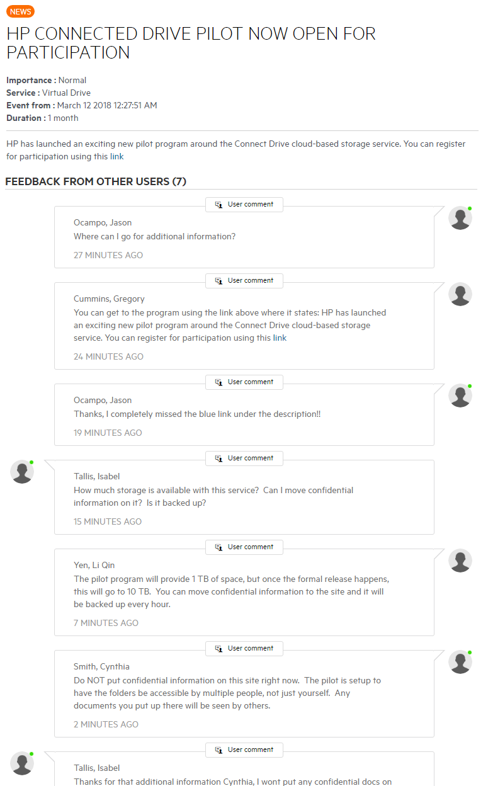
Screenshot: Public/Social requests
News provides information on new applications and/or services
Users are able to provide feedback or ask questions in the comment section
Key information can be discovered via chats that weren’t readily available (or known)

Slide 51
Modern UX for Enterprise Applications
Capability | Description & Use Case | Technology | Screenshot | Video
Service Manager Dashboard & Reporting
Service Request Management & Fulfillment
Incident & Problem Management
Service Level Management
Change Management
Release Management
Service Asset & Configuration Management (SACM)
Contract & Vendor Management
Software Asset Management
Idea & Proposal Management
Application Portfolio Management
Project Management
Human Resource Application
Procurement

Slide 52
Description: Service Manager Dashboards & Reporting
Create a report or add it to dashboard for real time updates on entire data center
Create Operational or Analytical reports
Multiple levels of grouping
Group date by period (year, month, day)
Group by and filter by related entity fields
Multiple function support (sum, count, average)
Public or restricted access designations
Use Cases
Create a new report to monitor incident reporting rate
Re-design the dashboard layout page based on specific group’s responsibilities

Slide 53
Technology: Database Performance
Continually run reports without impacting database performance
SM Server
To maximize Production DB Performance:
Report Monitor
Identifies poorly performing reports and disables them
Query Results Cache
Reduces the database CPU load from 100% to less than 30% (based on perf testing in lab)
Database Replication
Saves the production database from I/O traffic generated by heavy reporting. Leverages standard database synchronization mechanism.
Report
Report
Cache
Transactions
Cache
Production Database
Replicated Database
Notes:
The greatest concern when running reports is performance impact to the production database. Using Service Manager reports, we have resolved the performance concerns with three optimized solutions:
Report Monitor – helps administrators to easily catch, analyze the bad performing report and take further action to preserve production database performance.
Query Result Cache – reporting query results are cached, it reduces the database CPU load from 100% to less than 30% according to the performance testing result in our testing lab.
Database Replication – this significantly saves the production database to ensure a robust reporting feature.
Replication between the production and the replicated database is handled by RDBMS tools. Even a manual duplication could work, although it needs to be regularly updated.

Slide 54
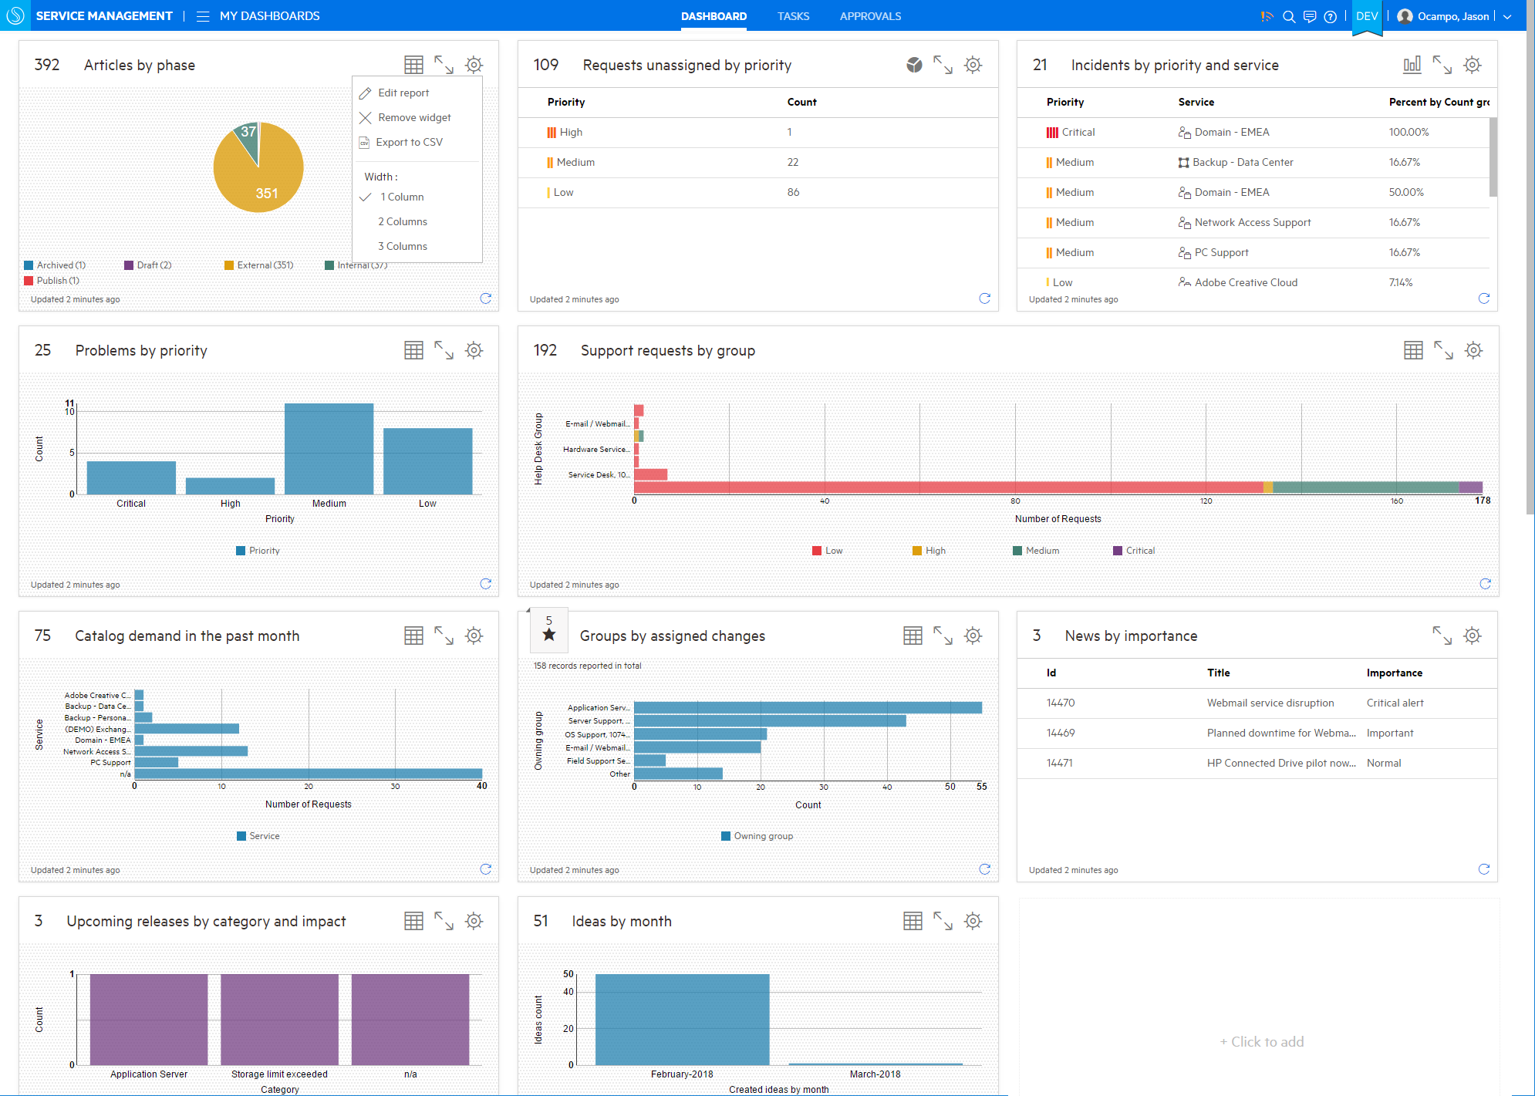
Screenshot: Service Manager Dashboards & Reporting
Personalized and role-based dashboards
Easily export for additional analytics or custom reports
200+ out of the box reports
12 Chart Types
(Bar chart, stacked bar, number, area, pie, pivot, line, list, bar, calculation, duration & hot topic map)
Drag and drop for resizing or moving reports
Near real-time reporting to proactively monitor
Intuitive UI allows easy addition of reports
Notes:
Service Manager reporting provides personalized and role based dashboards for all key IT processes. Users can see what they need to see and what they are supposed to see.
The flexible distribution of reports allows users to preserve snapshots of reports when needed.
Support a total of 12 report types and more than 200 out of the box reports covering all Service Manager modules.
Users can define their own reports via drag & drop functionality in seconds according to their business needs.
Duration measurements and calculation operators allow for easy to use KPI reporting
Note: Fresh data means real-time data right now.

Slide 55
Description: Request Management & Fulfillment
Integrated views of related records, news and knowledge
Executed dedicated fulfillment task plans for new service fulfillment, change and support
Assign manual tasks and delegate to other fulfillment processes
Orchestrate automated fulfillment tasks
Use Cases
Create new service fulfillment service for ordering a mobile phone

Slide 56
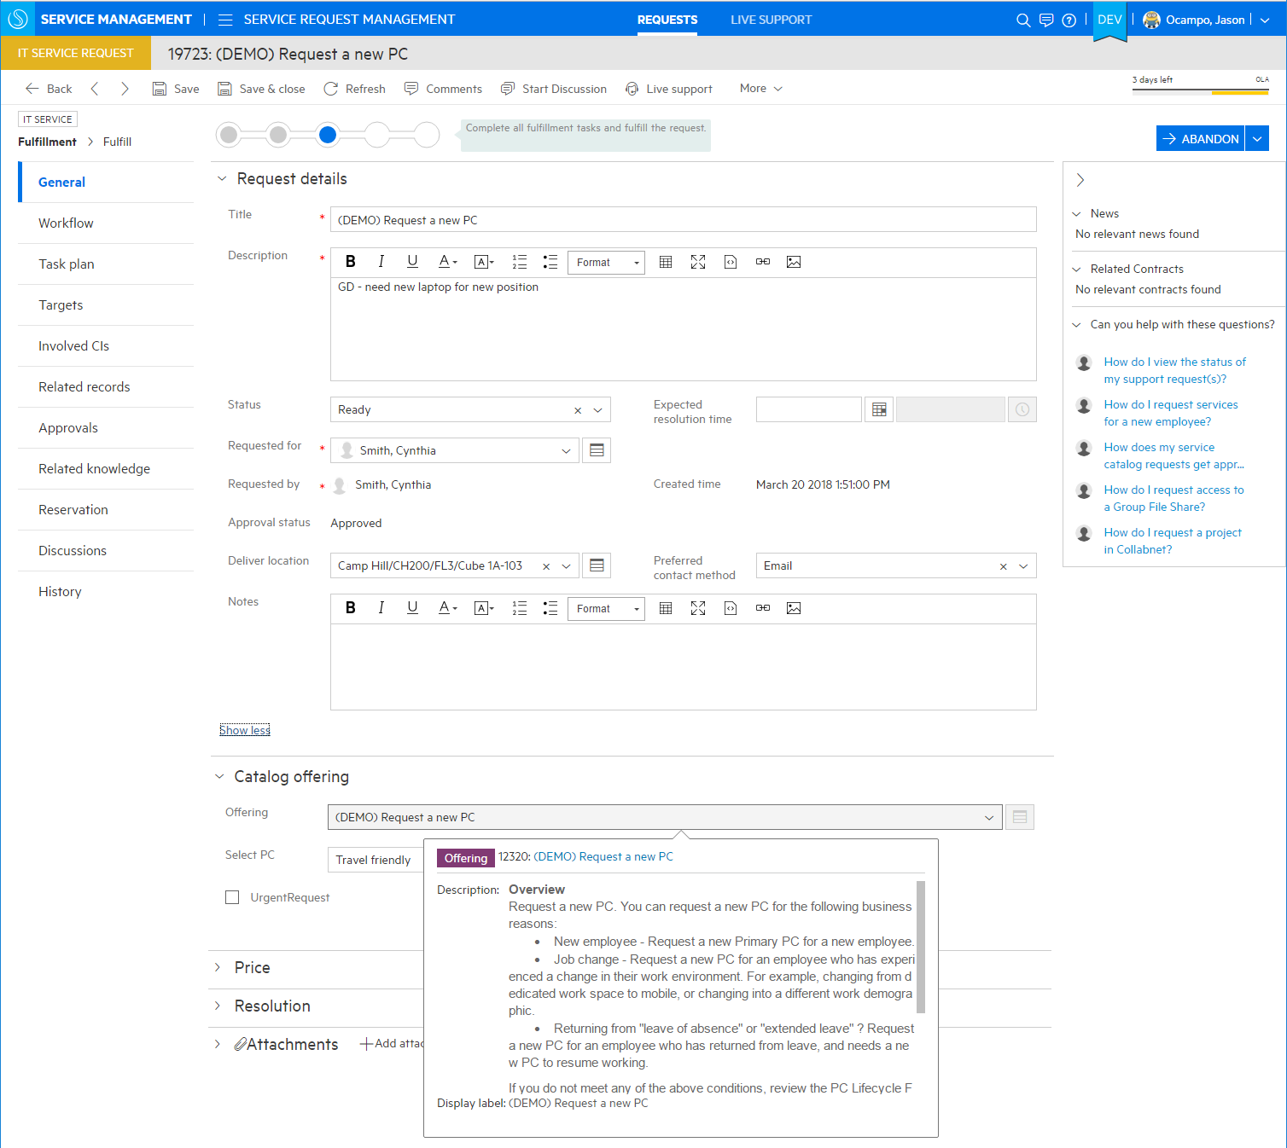
Screenshot: Service Request Management & Fulfillment
Assign manual tasks and delegate to other fulfillment processes
Integrated views of related records, news, and knowledge articles
Orchestrate automated fulfillment tasks
Execute dedicated fulfillment task plans for new Service fulfillment, change, and support
Notes:
Out of the box – ready to go workflow

Slide 57
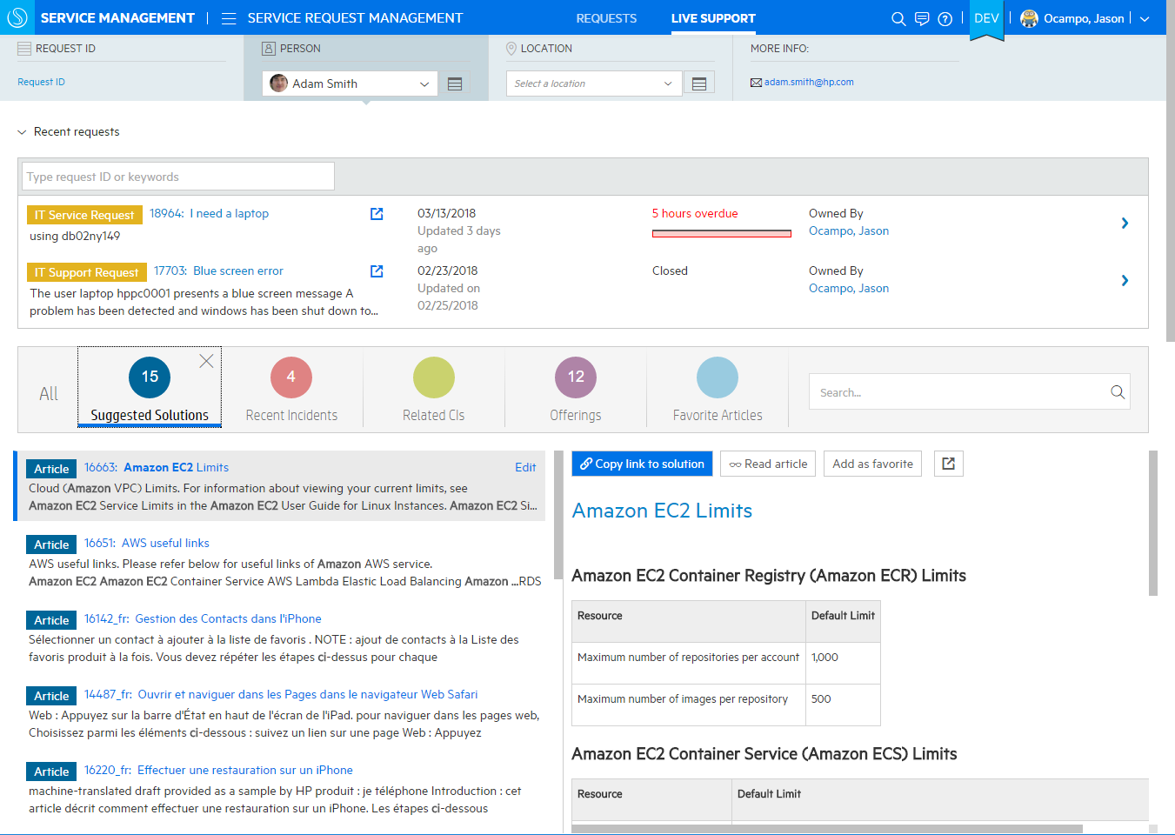
Screenshot: Live Support for existing service request
Optimized experience for live phone/chat based support, minimize clicks and maximize productivity
Caller details, including their recently opened requests
Context driven proactive suggestions of solutions and support offerings
Notes:
To access, navigate to Service Request Management, and click on the Live Support subtab.

Slide 58
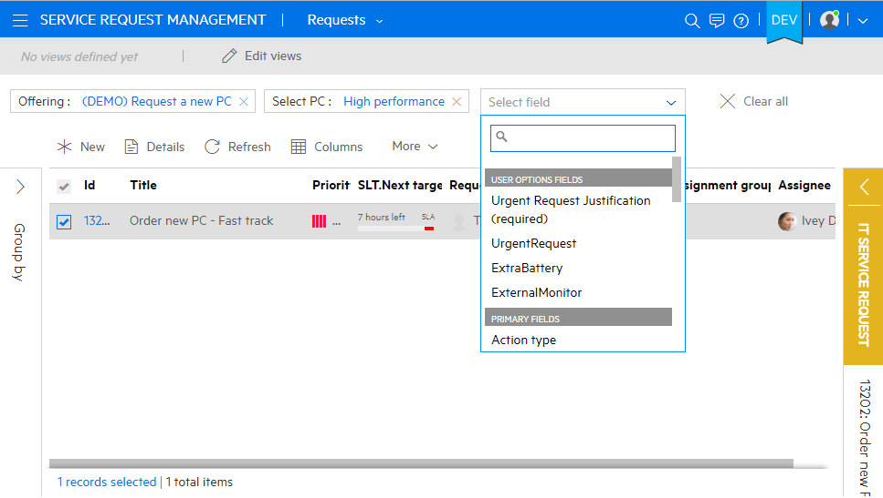
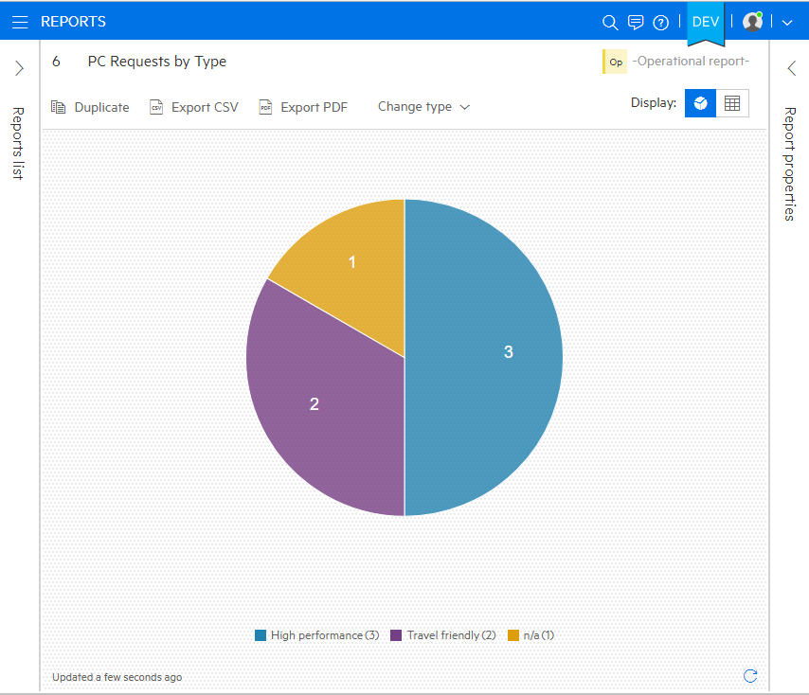
Screenshot: User Option Reporting
Specific offering or model must be filtered before user option reporting
User option fields can now:
Used as a filter on grid view
Be added as a column on grid views
Included in Group By in reports

Slide 59
Description: Incident & Problem Management
Pre-configured tasks and workflow to shrink response and fix rate times
Create reusable incident models and task plans
Consolidated display of related records
Related records and suggested solutions leverage structured and unstructured data sources for more complete answers
Use Cases
Determine root cause of incident via “Suggested Solutions” and close ticket

Slide 60
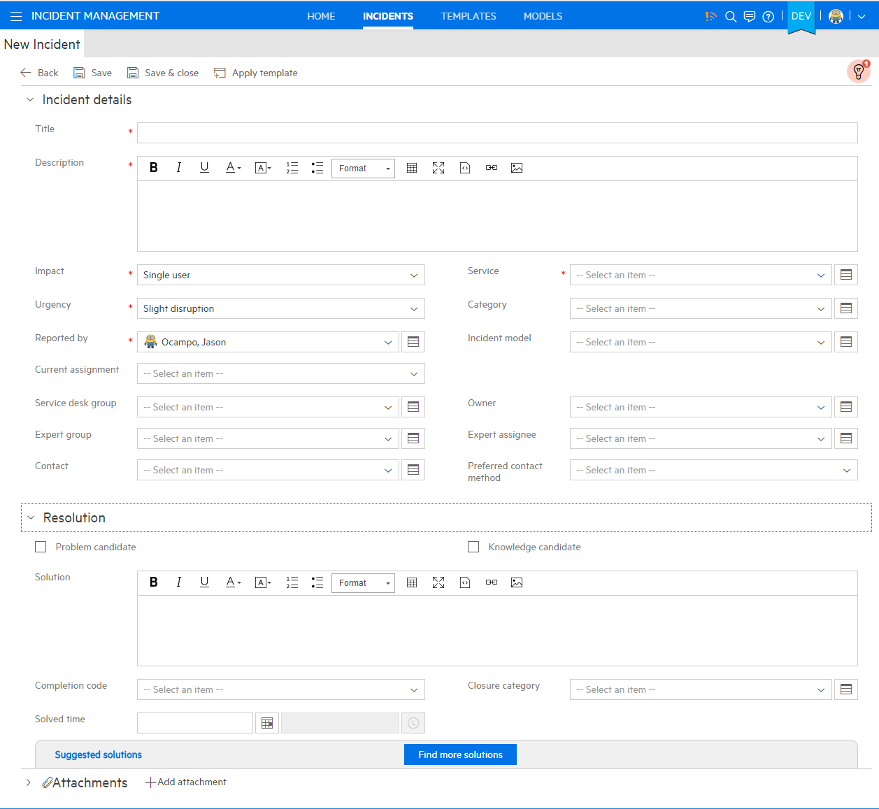
Screenshot: Incident Management
Pre-configured workflows to expedite ticket entry
Suggested solutions available after entering a title
Assign to group instead of guessing at appropriate direct assignee
Leverage knowledge, related solutions and matching incident/problem records with suggested solutions

Slide 61
Description: Service Level Management
Measure and track how well your org is meeting its Service Level Targets
Review and resolve response time targets
By service & priority
For Incident & Support Requests
Support different work schedules and exceptions (holidays)
Work queue prioritization
Next Service Level target field for filtering and sorting lists
Hierarchical escalation based on next target
SLT achievement reporting
Use Cases
Create new metrics report to determine time to resolution of incidents
Notes:
Use the reporting capabilities included in Service Anywhere to measure and track how well your organization is meeting its Service Level Targets. Use one of the 27 reports included with the system or configure your own report. You can now report on SLT achievement trends and average duration by Service, Group, Priority, and Impact. You can also report on the aggregated SLT status for Incidents and Support Requests.

Slide 62
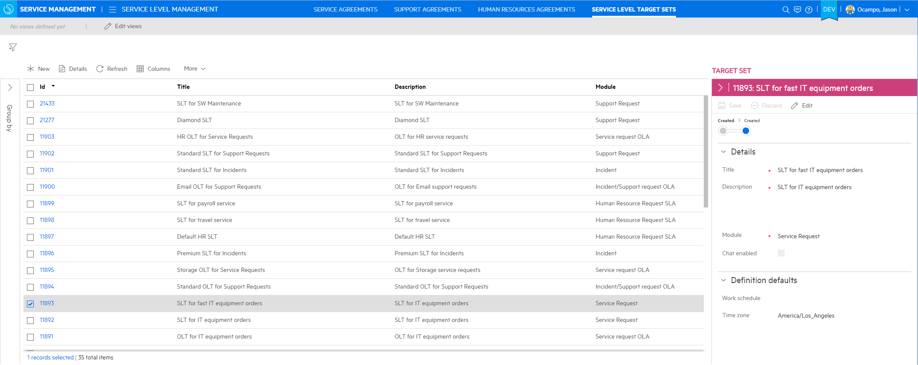
Screenshot: Service Level Management
Service Catalog Request SLTs
SLAs and OLA/UCs are linked to the Service Request through the Catalog Offering

Slide 63
Description: Change Management
Update/edit applications while minimizing risk and downtime
ITIL Aligned workflows
Normal
Standard
Emergency
Change models with task pans
View and edit the task plan on each RFC
Collaboration
Multiple conversations per change
Fast CI Detection
Quick CI association
Use Cases
Run through a change process via a “normal” workflow

Slide 64
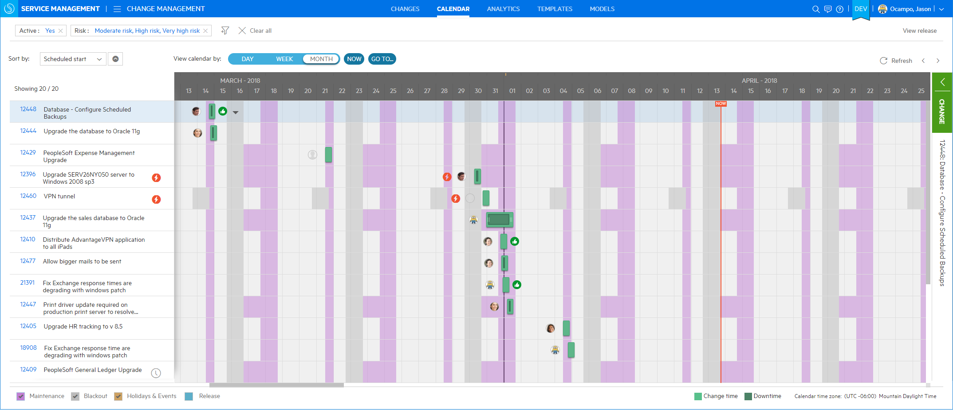
Screenshot: Change Calendar
Visualize change plans in forward schedule of changes
Flag changes that fall outside planned maintenance
Identify scheduled maintenance windows
Identify collisions with Black Out periods
Notes:
To access, navigate to the Change Management, and click on the Change Calendar sub-menu tab.

Slide 65
Description: Release Management
Operational-ize your application release
Release lifecycle
Manage the planning and deployment of the release and its related components
Use Cases
Schedule and Track unexpected changes during a release cycle
Notes:
Smart Ticket
The Smart Ticket capability enables users to submit self-service support requests in a very simple way.
With HPE Service Manager Smart Analytics in place, there is no need for the user to fill in any fields when submitting a ticket. All the user needs to do is to take a screenshot of the error message, attach it to the ticket, and click the “submit” button. The Optical Character Recognition (OCR) feature of Smart Analytics takes the text from the image and adds it into the Description of the interaction. This is known as the “unstructured data”.
Smart Ticket then takes that unstructured data and proposes the ticket classification based upon its learning of past interactions, setting the Category, Subcategory, Area and Affected Service.
Another option for the user is to just type in a couple of text lines to describe the error in natural language. All of the ticket details are completed automatically in the backend.
A superior user experience, better call routing, quicker resolution time
Automated ticketing for a superior End User experience:
Image based ticketing – just attach a picture
Takes self-service ticketing to the next level of simplification
Saves the end user time, effort and guess work
Faster and more accurate categorization, more accurate ticket routing.
IT Agent is more efficient as classification of interaction is proposed based off Smart Analytics learning from past tickets and therefore more accurate.
Via Web Client, an IT Agent can submit a Smart Ticket by just typing a Description, clicking Smart Classification and then Continue.

Slide 66
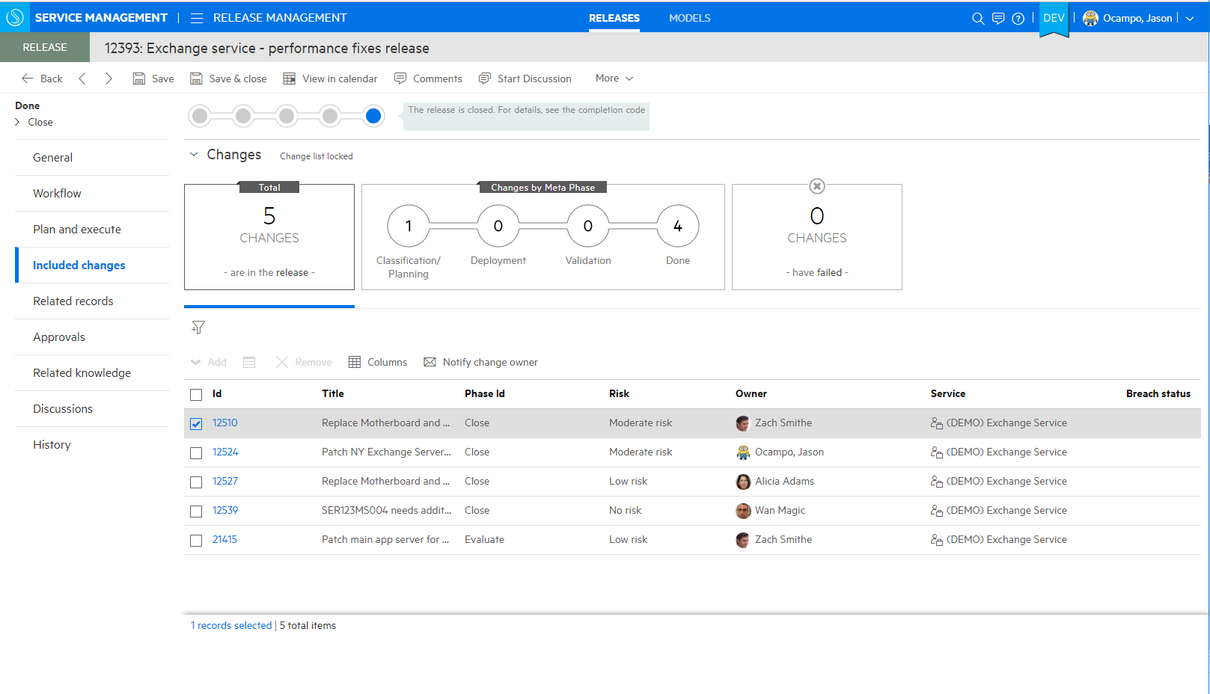
Screenshot: Release Management
Operationalize your application releases more
Actionable tiles that drill into changes under different release statuses
Quickly review all planed, related changes for a given cycle

Slide 67
Description: Service Asset & Configuration Management
Optimize asset utilization and contract value while reconciling finance and IT views
Asset tracking
Asset modeling, asset types & sub-types
Manage license, infrastructure and peripheral
Manage lifecycle and contractual information
Enhanced Configuration Management
Integration with UCMDB/UD
Improved display of complex attributes, e.g. CPUs
Asset reconciliation & normalization
Use Cases
Update existing assets and align licensing details with new infrastructure
Notes:
Smart Ticket
The Smart Ticket capability enables users to submit self-service support requests in a very simple way.
With HPE Service Manager Smart Analytics in place, there is no need for the user to fill in any fields when submitting a ticket. All the user needs to do is to take a screenshot of the error message, attach it to the ticket, and click the “submit” button. The Optical Character Recognition (OCR) feature of Smart Analytics takes the text from the image and adds it into the Description of the interaction. This is known as the “unstructured data”.
Smart Ticket then takes that unstructured data and proposes the ticket classification based upon its learning of past interactions, setting the Category, Subcategory, Area and Affected Service.
Another option for the user is to just type in a couple of text lines to describe the error in natural language. All of the ticket details are completed automatically in the backend.
A superior user experience, better call routing, quicker resolution time
Automated ticketing for a superior End User experience:
Image based ticketing – just attach a picture
Takes self-service ticketing to the next level of simplification
Saves the end user time, effort and guess work
Faster and more accurate categorization, more accurate ticket routing.
IT Agent is more efficient as classification of interaction is proposed based off Smart Analytics learning from past tickets and therefore more accurate.
Via Web Client, an IT Agent can submit a Smart Ticket by just typing a Description, clicking Smart Classification and then Continue.

Slide 68

Screenshot: Service Asset & Configuration Management
Full environment views to quickly locate specific assets
Asset modeling aligned with UNSPSC

Slide 69

Screenshot: Service Asset & Configuration Management
Dashboard view enables real time updates of entire environment

Slide 70
Description: Contract & Vendor Management
Manage contract lifecycle – from creation through signature to expiration
Track vendors, their brands and the contracts
Vendor relationship management
Understand asset, service and/or persons covered under contract
Notification of contract expiration
Use Cases
Add new contract to existing master contract
Remove vendor relationship
Notes:
Smart Ticket
The Smart Ticket capability enables users to submit self-service support requests in a very simple way.
With HPE Service Manager Smart Analytics in place, there is no need for the user to fill in any fields when submitting a ticket. All the user needs to do is to take a screenshot of the error message, attach it to the ticket, and click the “submit” button. The Optical Character Recognition (OCR) feature of Smart Analytics takes the text from the image and adds it into the Description of the interaction. This is known as the “unstructured data”.
Smart Ticket then takes that unstructured data and proposes the ticket classification based upon its learning of past interactions, setting the Category, Subcategory, Area and Affected Service.
Another option for the user is to just type in a couple of text lines to describe the error in natural language. All of the ticket details are completed automatically in the backend.
A superior user experience, better call routing, quicker resolution time
Automated ticketing for a superior End User experience:
Image based ticketing – just attach a picture
Takes self-service ticketing to the next level of simplification
Saves the end user time, effort and guess work
Faster and more accurate categorization, more accurate ticket routing.
IT Agent is more efficient as classification of interaction is proposed based off Smart Analytics learning from past tickets and therefore more accurate.
Via Web Client, an IT Agent can submit a Smart Ticket by just typing a Description, clicking Smart Classification and then Continue.

Slide 71


Screenshot: Contract and Vendor Management
Dynamically see relevant contract information
View related contracts & end of terms
Master view of all contracts in effect and about to expire

Slide 72
Description: Software Asset Management
Classify your software license and define how licenses are consumed
License Assets
Publisher
Quantity
Number of rights
License contract information
Use Cases
Run a compliance audit to ensure that all software is properly licensed for the current number of employees using them
Notes:
Smart Ticket
The Smart Ticket capability enables users to submit self-service support requests in a very simple way.
With HPE Service Manager Smart Analytics in place, there is no need for the user to fill in any fields when submitting a ticket. All the user needs to do is to take a screenshot of the error message, attach it to the ticket, and click the “submit” button. The Optical Character Recognition (OCR) feature of Smart Analytics takes the text from the image and adds it into the Description of the interaction. This is known as the “unstructured data”.
Smart Ticket then takes that unstructured data and proposes the ticket classification based upon its learning of past interactions, setting the Category, Subcategory, Area and Affected Service.
Another option for the user is to just type in a couple of text lines to describe the error in natural language. All of the ticket details are completed automatically in the backend.
A superior user experience, better call routing, quicker resolution time
Automated ticketing for a superior End User experience:
Image based ticketing – just attach a picture
Takes self-service ticketing to the next level of simplification
Saves the end user time, effort and guess work
Faster and more accurate categorization, more accurate ticket routing.
IT Agent is more efficient as classification of interaction is proposed based off Smart Analytics learning from past tickets and therefore more accurate.
Via Web Client, an IT Agent can submit a Smart Ticket by just typing a Description, clicking Smart Classification and then Continue.

Slide 73

Screenshot: Software Asset Management
Manage your license assets
Define how licenses can be consumed and checked for compliance
Classify software license with hierarchical models
Easily determine publisher, quantity of license and contract information of software

Slide 74

Screenshot: Asset Financial Management
Control your IT assets cost
Provides insight into asset financials
Better understand asset cost with tracking cost centers and cost types
Financial asset information: purchase price, resale, taxes, net value

Slide 75
Description: Idea & Proposal Management
Actionable forum for sharing ideas and enhancement requests
Approval Governance
Define default approval process for all ideas
Define specific approval processes for strategic ideas
Analyze input to initiate & drive service proposals or change requests
Visibility into cost/benefit opportunities
Use Cases
End user submits an idea via the self-service portal
Notes:
Smart Ticket
The Smart Ticket capability enables users to submit self-service support requests in a very simple way.
With HPE Service Manager Smart Analytics in place, there is no need for the user to fill in any fields when submitting a ticket. All the user needs to do is to take a screenshot of the error message, attach it to the ticket, and click the “submit” button. The Optical Character Recognition (OCR) feature of Smart Analytics takes the text from the image and adds it into the Description of the interaction. This is known as the “unstructured data”.
Smart Ticket then takes that unstructured data and proposes the ticket classification based upon its learning of past interactions, setting the Category, Subcategory, Area and Affected Service.
Another option for the user is to just type in a couple of text lines to describe the error in natural language. All of the ticket details are completed automatically in the backend.
A superior user experience, better call routing, quicker resolution time
Automated ticketing for a superior End User experience:
Image based ticketing – just attach a picture
Takes self-service ticketing to the next level of simplification
Saves the end user time, effort and guess work
Faster and more accurate categorization, more accurate ticket routing.
IT Agent is more efficient as classification of interaction is proposed based off Smart Analytics learning from past tickets and therefore more accurate.
Via Web Client, an IT Agent can submit a Smart Ticket by just typing a Description, clicking Smart Classification and then Continue.

Slide 76

Screenshot: Idea and Proposal Management
Improve IT customer satisfaction and innovate by leveraging power of crowdsourcing
Easily see cost/benefit opportunities
Leverage analytics to determine most cost effective proposals and ideas

Slide 77
Description: Application Portfolio Management
Manage the complete lifecycle of your services
Application Portfolio
Inventory of all your applications
Applications roadmaps
Provide a view into portfolio health
Portfolio Optimization
Survey data collection
Identify optimal cloud-based application delivery model
Use Cases
Deploy a new cloud-based application
Notes:
Smart Ticket
The Smart Ticket capability enables users to submit self-service support requests in a very simple way.
With HPE Service Manager Smart Analytics in place, there is no need for the user to fill in any fields when submitting a ticket. All the user needs to do is to take a screenshot of the error message, attach it to the ticket, and click the “submit” button. The Optical Character Recognition (OCR) feature of Smart Analytics takes the text from the image and adds it into the Description of the interaction. This is known as the “unstructured data”.
Smart Ticket then takes that unstructured data and proposes the ticket classification based upon its learning of past interactions, setting the Category, Subcategory, Area and Affected Service.
Another option for the user is to just type in a couple of text lines to describe the error in natural language. All of the ticket details are completed automatically in the backend.
A superior user experience, better call routing, quicker resolution time
Automated ticketing for a superior End User experience:
Image based ticketing – just attach a picture
Takes self-service ticketing to the next level of simplification
Saves the end user time, effort and guess work
Faster and more accurate categorization, more accurate ticket routing.
IT Agent is more efficient as classification of interaction is proposed based off Smart Analytics learning from past tickets and therefore more accurate.
Via Web Client, an IT Agent can submit a Smart Ticket by just typing a Description, clicking Smart Classification and then Continue.

Slide 78

Screenshot: Application Portfolio Management
Overview of all applications to be deployed and length of deployment
Delve into specific details for an application

Slide 79
Description: Project Management
Track your operational projects and programs
Implement large changes or releases
Extend ideation & proposal to project and program management
Track proposal, project and program as portfolios
Use Cases
Create a dashboard report on current project status
Notes:
Smart Ticket
The Smart Ticket capability enables users to submit self-service support requests in a very simple way.
With HPE Service Manager Smart Analytics in place, there is no need for the user to fill in any fields when submitting a ticket. All the user needs to do is to take a screenshot of the error message, attach it to the ticket, and click the “submit” button. The Optical Character Recognition (OCR) feature of Smart Analytics takes the text from the image and adds it into the Description of the interaction. This is known as the “unstructured data”.
Smart Ticket then takes that unstructured data and proposes the ticket classification based upon its learning of past interactions, setting the Category, Subcategory, Area and Affected Service.
Another option for the user is to just type in a couple of text lines to describe the error in natural language. All of the ticket details are completed automatically in the backend.
A superior user experience, better call routing, quicker resolution time
Automated ticketing for a superior End User experience:
Image based ticketing – just attach a picture
Takes self-service ticketing to the next level of simplification
Saves the end user time, effort and guess work
Faster and more accurate categorization, more accurate ticket routing.
IT Agent is more efficient as classification of interaction is proposed based off Smart Analytics learning from past tickets and therefore more accurate.
Via Web Client, an IT Agent can submit a Smart Ticket by just typing a Description, clicking Smart Classification and then Continue.

Slide 80

Screenshot: Project Mgmt & Portfolio Optimization
Overall project status & projections
Determine cost overruns by quarter
Notes:
2 way integration with Change and Release
create project from change or release record
create program from change or release record
Service Anywhere will now present all linked projects in ”Related Records” of changes and release.
Create service request from project such as when to request assets for a project and pick from offerings. These project assets are tracked under “Subscribed Assets” part of the project details.

Slide 81
Description: Human Resources Application
Dedicated processes and support for HR best practices
HR Support Request
Configured and managed separately from IT service catalog requesting processes
Designed to streamline processes not requiring approval or validation
Editable Meta phase “Display” name
Configure end user facing display name
Also applies to IT Support and Service processes
Use Cases
Find additional information on companies’ FMLA policy

Slide 82

Screenshot: Human Resources application
Full search capabilities specific to Human Resources
Request support, read articles, or see the latest offerings
Browse community questions for common asked questions
Notes:
A new “application” – a new “workflow”
Existing customers have been supporting HR through the standard request management process. This pre-packaged feature is more tailored out of the box to suit HR processes

Slide 83
Video: Human Resources Application
HR Overview
Notes:
Smart Ticket
The Smart Ticket capability enables users to submit self-service support requests in a very simple way.
With HPE Service Manager Smart Analytics in place, there is no need for the user to fill in any fields when submitting a ticket. All the user needs to do is to take a screenshot of the error message, attach it to the ticket, and click the “submit” button. The Optical Character Recognition (OCR) feature of Smart Analytics takes the text from the image and adds it into the Description of the interaction. This is known as the “unstructured data”.
Smart Ticket then takes that unstructured data and proposes the ticket classification based upon its learning of past interactions, setting the Category, Subcategory, Area and Affected Service.
Another option for the user is to just type in a couple of text lines to describe the error in natural language. All of the ticket details are completed automatically in the backend.
A superior user experience, better call routing, quicker resolution time
Automated ticketing for a superior End User experience:
Image based ticketing – just attach a picture
Takes self-service ticketing to the next level of simplification
Saves the end user time, effort and guess work
Faster and more accurate categorization, more accurate ticket routing.
IT Agent is more efficient as classification of interaction is proposed based off Smart Analytics learning from past tickets and therefore more accurate.
Via Web Client, an IT Agent can submit a Smart Ticket by just typing a Description, clicking Smart Classification and then Continue.

Slide 84
Description: Procurement Management
Track and manage IT purchasing information
Facilitate asset management lifecycle decisions
Facilitate asset receiving with the creation of a receiving slip
Facilitate stock management by moving assets into stock
Track vendor catalog details
Use Cases
Create vendor catalogs & catalog items and publish as service offerings
Manage purchase orders & purchase order lines

Slide 85

Screenshot: Vendor catalog
View catalog of all vendor information
Create new catalog IDs or edit existing
Notes:
New?

Slide 86

Screenshot: Purchase request
Request ID & name
The task plan will generate a purchase order during request fulfillment

Slide 87

Screenshot: Purchase order
Purchase Order ID & name
List of all details within purchase order

Slide 88

Screenshot: Receiving slip
Receiving slid ID & name
List of receiving line details

Slide 89
Codeless Configuration and Easy Updates
Capability | Description & Use Case | Technology | Screenshot | Video
Studio
Update Process

Slide 90
Description: Studio
Instant creation of new service management applications
Support all services, not just IT
Seamless updates
Fast and risk-free configuration and extension
Designed for IT and line-of-business (non-IT) personnel
Process owners can configure their own process rules
Use Cases
Create new user-defined process-based applications
Create supporting tables to be used within existing (or new) applications
Expanded codeless configuration features for greater modifications of existing applications

Slide 91


Screenshot: Studio Basics
Entity links: one-to-many reference to another table
Relations: many-to-many reference to another table
Create new tables / add entries to menu structure
Define forms, configure workflow and/or add business rules

Slide 92

Screenshot: Studio Approval Support
Create approval definitions
Visualization of all processes
Enable approval plans in a workflow

Slide 93

Screenshot: Studio Custom Actions
Configure to trigger a workflow and call one or more business rules
Trigger business rules from the custom action button

Slide 94

Screenshot: Studio Service Level Management
Service Level Management support for user-defined record types
Define Service Level Targets (SLTs)
Configure start, stop and suspend conditions

Slide 95
Description: Update Process
A guide to upgrading SMAX
In-place update with “minimum downtime”
Use Cases
Update SMAX to the latest version

Slide 96

Technology: In place update for the SMA Suite
New “in-place update” framework updates SMA-services according to the service dependencies
Rolling updates to the SMA suite ensure that suite is updated with minimal downtime
Backup DB and NFS
Update master nodes and worker nodes with latest CDF
Master and worker nodes must be updated one by one to ensure availability
Run suite update from admin UI
Post update process
Rollback in case update fails – use the restore service to restore data
Example of service dependencies in SMAX
Steps to update CDF/SMA suite

Slide 97

Technology: Version Update High Level Process Intro

Slide 98
Technology: Duration & Downtime
Steps | Duration | Downtime
Clone an existing installation to a test environment | Database backup restore time + 30 minutes installation time | 0 minutes
CDF Update | 40minutes per master node 10 minutes per worker node | 20minutes per master node + worker node update downtime
Suite Update | 30 minutes – 60 minutes | 30 minutes
Post Update | 0 – 120 minutes | 0 – 60 minutes

Slide 99
ITOM Platform with Deployment Choice
Capability | Description & Use Case | Technology | Screenshot | Video
AWS Deployment
Azure Deployment
Multi-tenant Console
ChatOps

Slide 100

Description: AWS Deployment
Deploy through the use of Cloud Formation templates
Deploy with multiple availability zones (AZ)
Use Cases
Deploy AWS cloud solution

Slide 101


Technology: SMAX on AWS
Built for
Support for Application load balancer (ALB) and network load balancer (NLB) to ensure HA and performance
Ability to deploy master nodes across multi-availability zones (AZs) on AWS

Slide 102

Screenshot: Availability on the AWS Markeplace
Built for
SMA-X on CDF delivered in the AWS marketplace
Pricing model is BYOL (bring your own license)
Elastic IP and FQDN needed for provisioning on marketplace
Deploy and run software under an AWS account on AWS infrastructure
Notes:
Benefits:
Single click SMA-X deployment on AWS
Easy deployment and consumption of SMA, while the customer controls the data
Great demo and POC experience – available in any AWS region
SM customers and prospects can explore additional use cases (e.g. LOB service desk) quickly and cost effectively
SMA-X is approved by AWS Professional Services (ProServe) consultants that the software is designed reliable, secure, efficient cost-effective for the cloud.

Slide 103
Description: Azure Deployment
NetApp ONTAP Cloud for Azure needed for storage solution to meet perf requirements (production deployments)
Self-managed PostgreSQL must be used (no Azure-managed)
Support for Azure Multiple Availability Zones
Support for Azure Auto scaling K8s Nodes (VMs)
Azure file NOT supported
Azure Internal Load Balancer NOT supported
Use Cases
Deploy SMAX with Medium profile (up to 500 concurrent agents)

Slide 104
Technology: SMAX on Azure
Azure public cloud is supported for deployment of SMAX
Uses Azure native services like: Azure VM, Azure Vnet, Azure load balancer, Azure NSG.
Supports Enterprise readiness for the suite including HA (multiple masters), and deployment automation

Slide 105
Description: Multi-tenant Console
Administrate across multiple tenants in a single console view
Edit records across multiple tenants in a single view
Restrict access for agents to specific tenants
View incidents and records in a multiple or single tenant view
Use Cases
Multiple tenants in a single UI
Add, edit, delete and license new or existing tenants
Notes:
Smart Ticket
The Smart Ticket capability enables users to submit self-service support requests in a very simple way.
With HPE Service Manager Smart Analytics in place, there is no need for the user to fill in any fields when submitting a ticket. All the user needs to do is to take a screenshot of the error message, attach it to the ticket, and click the “submit” button. The Optical Character Recognition (OCR) feature of Smart Analytics takes the text from the image and adds it into the Description of the interaction. This is known as the “unstructured data”.
Smart Ticket then takes that unstructured data and proposes the ticket classification based upon its learning of past interactions, setting the Category, Subcategory, Area and Affected Service.
Another option for the user is to just type in a couple of text lines to describe the error in natural language. All of the ticket details are completed automatically in the backend.
A superior user experience, better call routing, quicker resolution time
Automated ticketing for a superior End User experience:
Image based ticketing – just attach a picture
Takes self-service ticketing to the next level of simplification
Saves the end user time, effort and guess work
Faster and more accurate categorization, more accurate ticket routing.
IT Agent is more efficient as classification of interaction is proposed based off Smart Analytics learning from past tickets and therefore more accurate.
Via Web Client, an IT Agent can submit a Smart Ticket by just typing a Description, clicking Smart Classification and then Continue.

Slide 106

Overview: Multi-tenant Console
Work with multiple tenants in a single user interface
Multiple customers in a single console
Request details with impact, urgency etc.
Customer A
Service level targets and priority indicate importance and urgency
Customer B
Notes:
NOTE: Screenshot shows SMA-X

Slide 107

Screenshot: Suite Administration
Simplified tenant and license management
Allow partners and customers to localize into additional languages
Event/job history
Delete obsolete tenants
Revoke and reuse licenses
Notes:
NOTE: Screenshot shows SMA-X

Slide 108
Description: ChatOps for SMAX
ITOM Platform Service
Provide visibility & collaboration to support technical excellence & comradery across distributed work forces
Download from Marketplace
ChatOps white paper here
Use Cases
Exchange information
Trigger activities
Automate manual tasks
Notes:
Smart Ticket
The Smart Ticket capability enables users to submit self-service support requests in a very simple way.
With HPE Service Manager Smart Analytics in place, there is no need for the user to fill in any fields when submitting a ticket. All the user needs to do is to take a screenshot of the error message, attach it to the ticket, and click the “submit” button. The Optical Character Recognition (OCR) feature of Smart Analytics takes the text from the image and adds it into the Description of the interaction. This is known as the “unstructured data”.
Smart Ticket then takes that unstructured data and proposes the ticket classification based upon its learning of past interactions, setting the Category, Subcategory, Area and Affected Service.
Another option for the user is to just type in a couple of text lines to describe the error in natural language. All of the ticket details are completed automatically in the backend.
A superior user experience, better call routing, quicker resolution time
Automated ticketing for a superior End User experience:
Image based ticketing – just attach a picture
Takes self-service ticketing to the next level of simplification
Saves the end user time, effort and guess work
Faster and more accurate categorization, more accurate ticket routing.
IT Agent is more efficient as classification of interaction is proposed based off Smart Analytics learning from past tickets and therefore more accurate.
Via Web Client, an IT Agent can submit a Smart Ticket by just typing a Description, clicking Smart Classification and then Continue.

Slide 109

Screenshot: Hyperlink to Suggested Knowledge Articles
Suggest-solution incident command
Hyperlink to the suggested knowledge article

Slide 110

Screenshot: Search Incident & Knowledge Articles
Search incident command
Returned incidents
Returned knowledge articles

Slide 111

Screenshot: Help Command by ChatOps Platform
Help incident command
Help info with comprehensive guidance

Slide 112

Screenshot: Misspelling Correction
Get incident command with a typo of ‘icnident’
Misspelling correction response

Slide 113













Additional Information
Brochures, data sheets
eBooks
Videos
Whitepapers
www.microfocus.com/itsm
Analyst reports
Infographics
SMA community
Customer stories

Slide 114
Thank You

